Slide 1


Informatica Data Quality Classifier Model

Slide 2
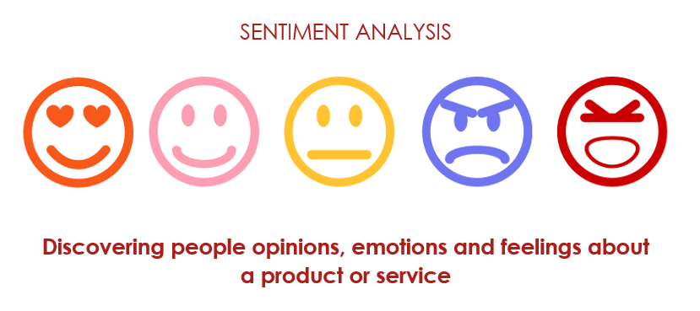
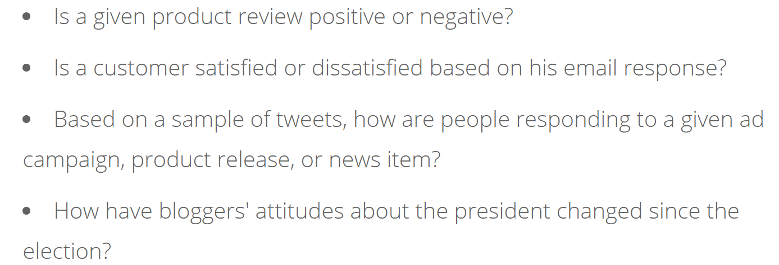

Slide 3
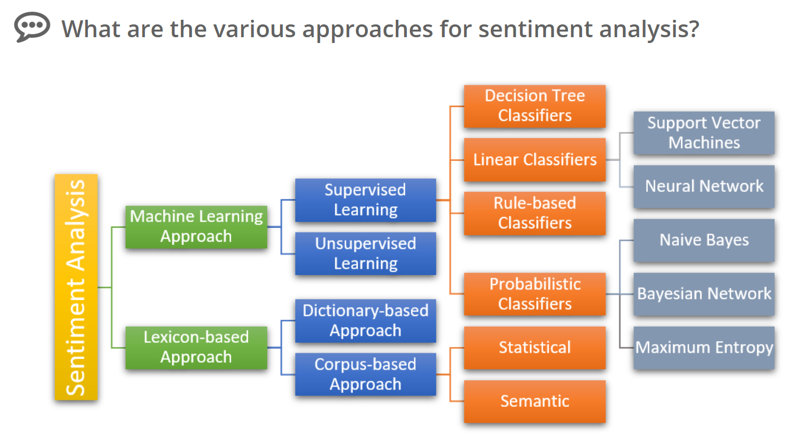

Slide 4
Naïve Bayes Algorithm ➔ Classifier ➔ Prediction ML Algorithm

Slide 5
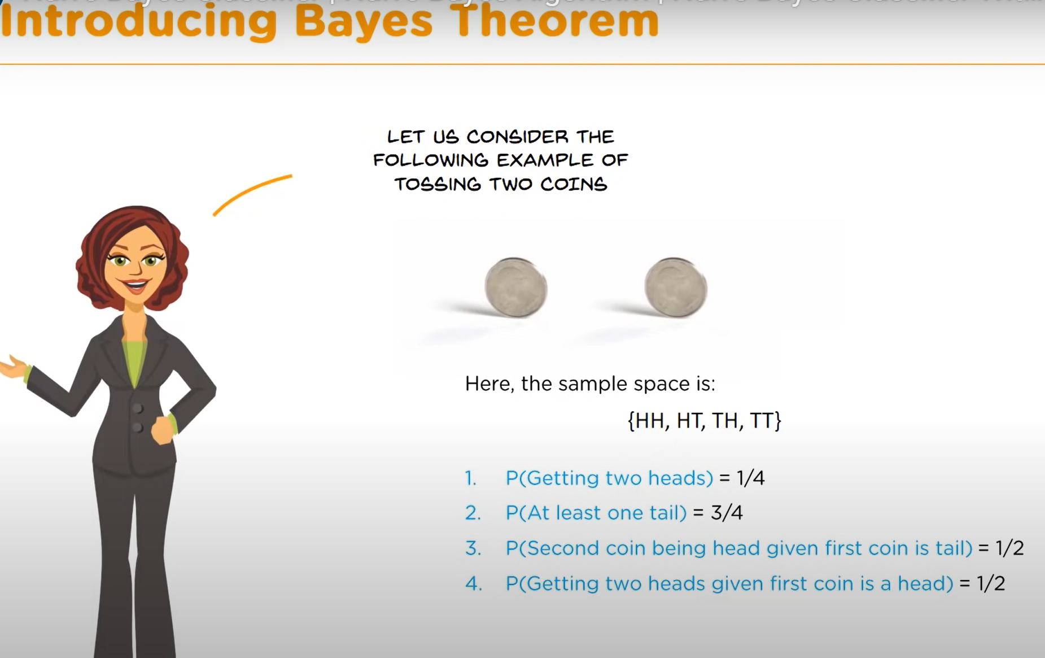
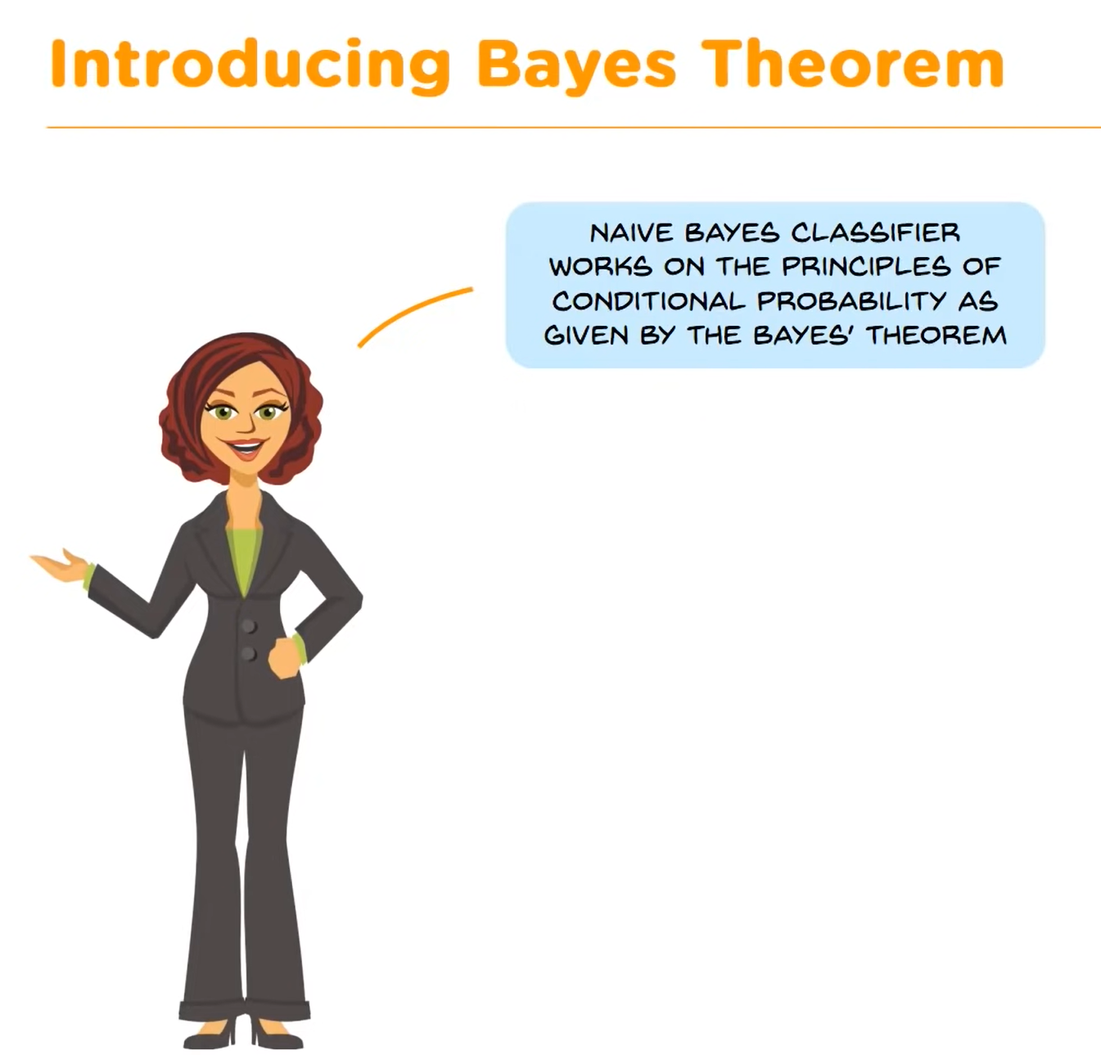

Slide 6
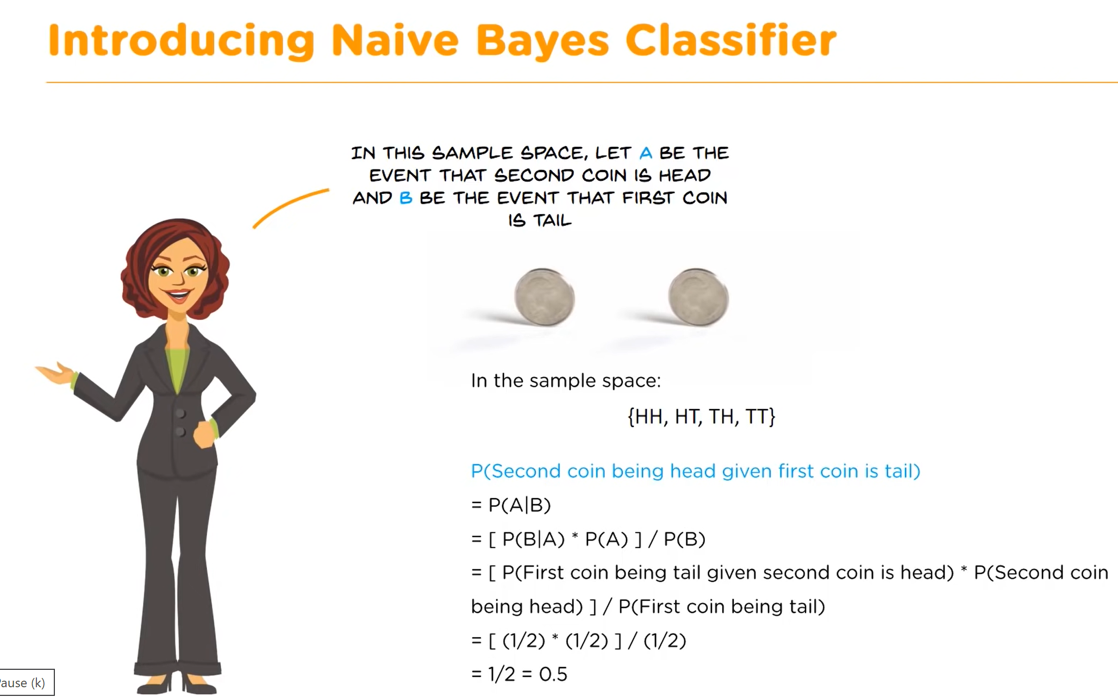
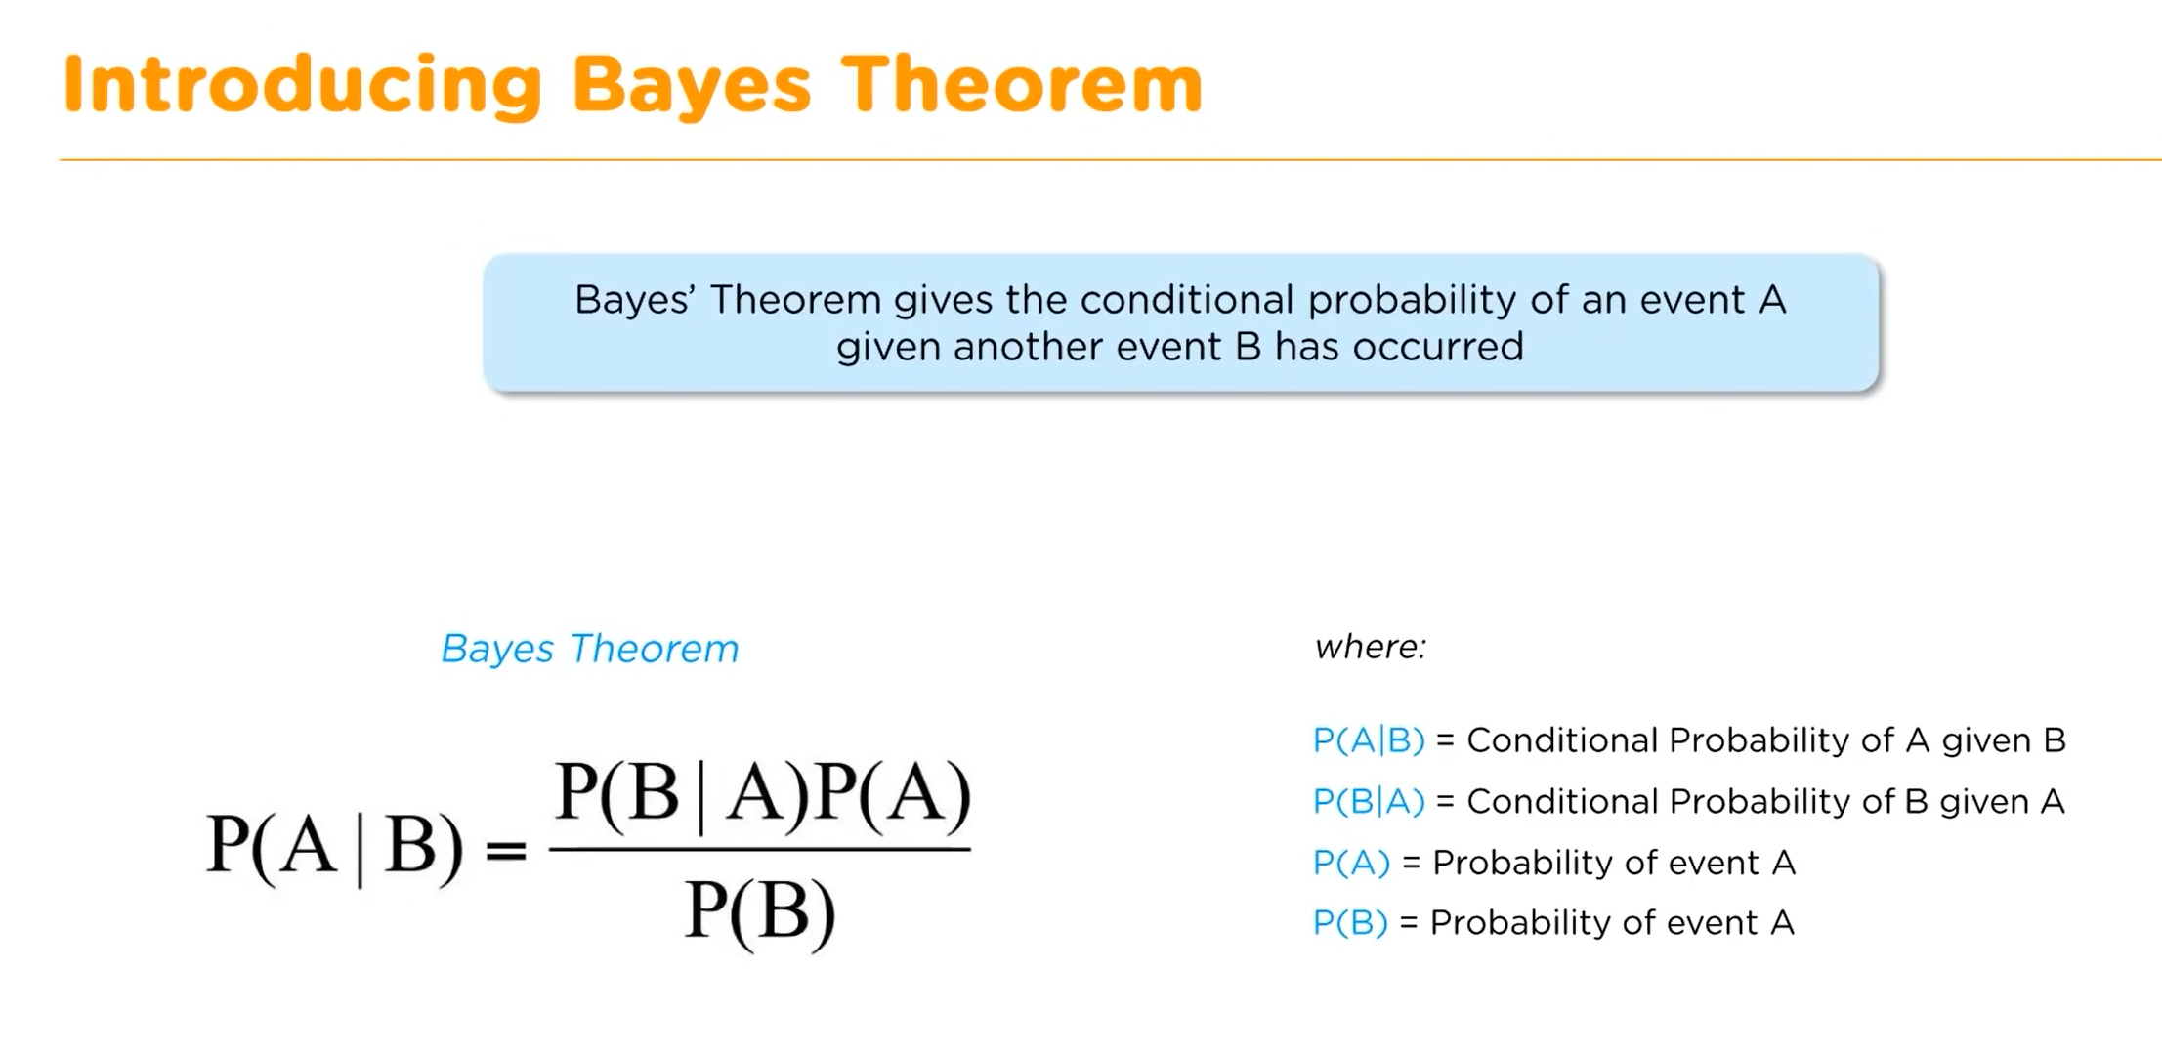

Slide 7
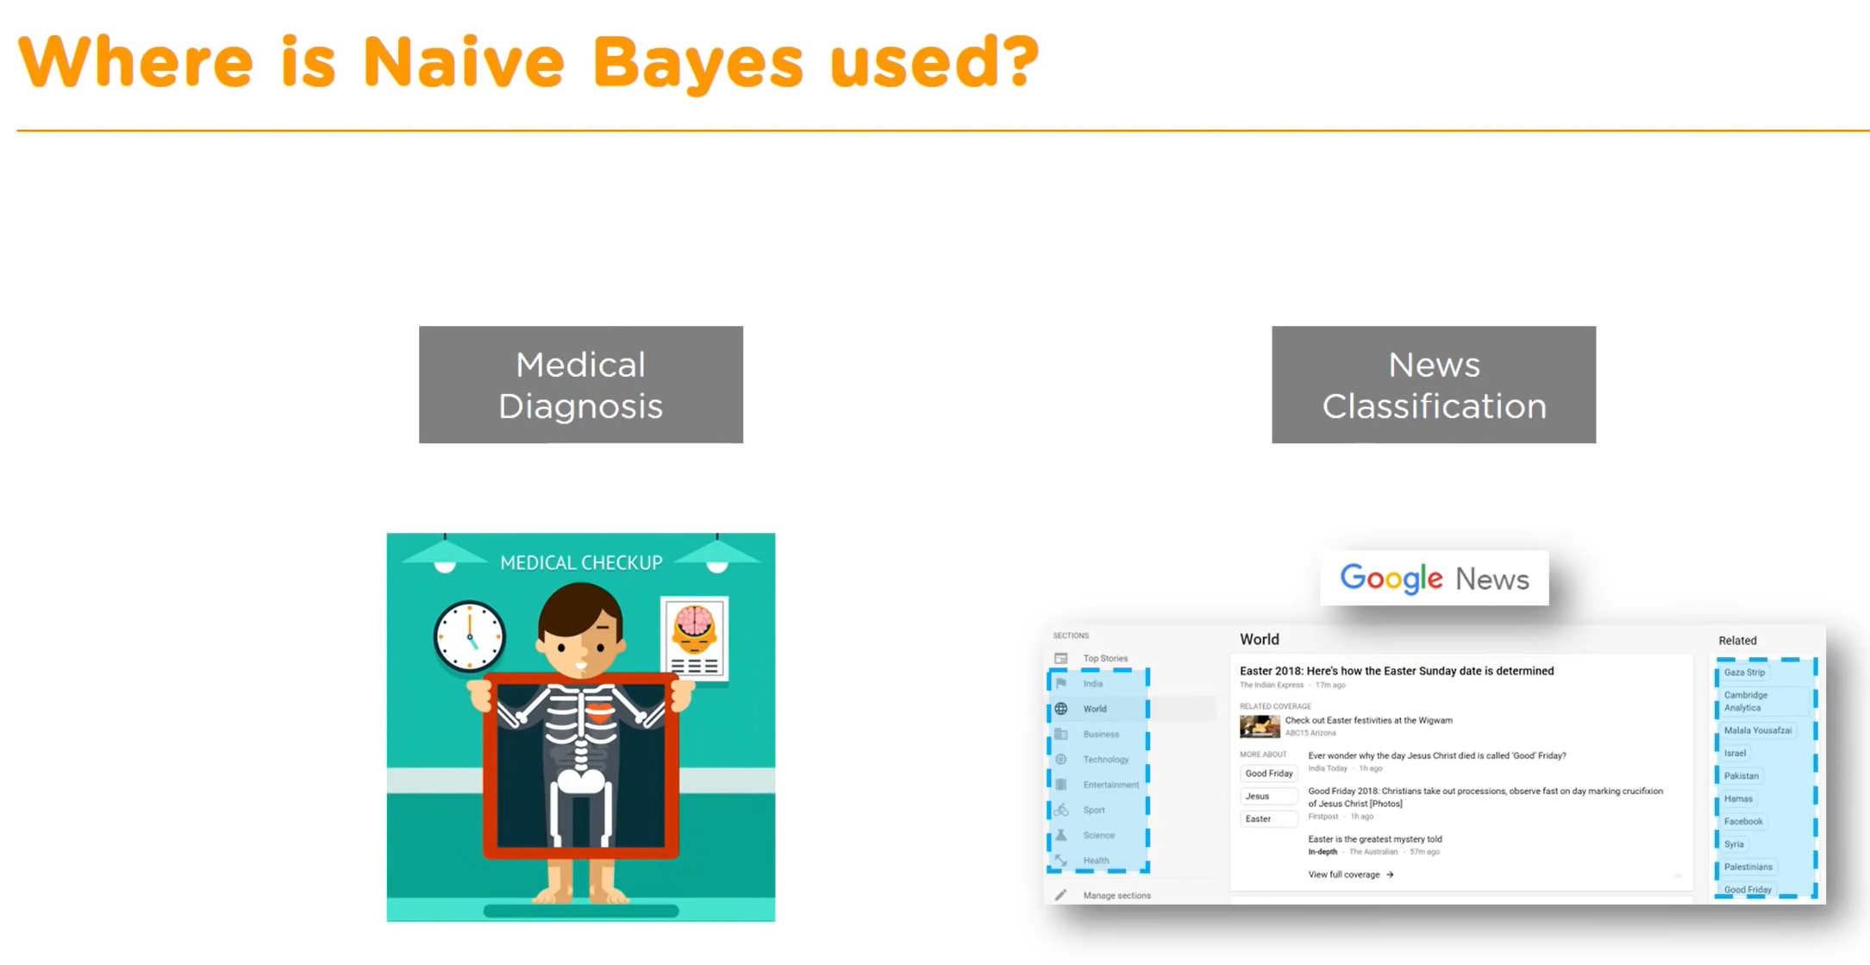

Slide 8
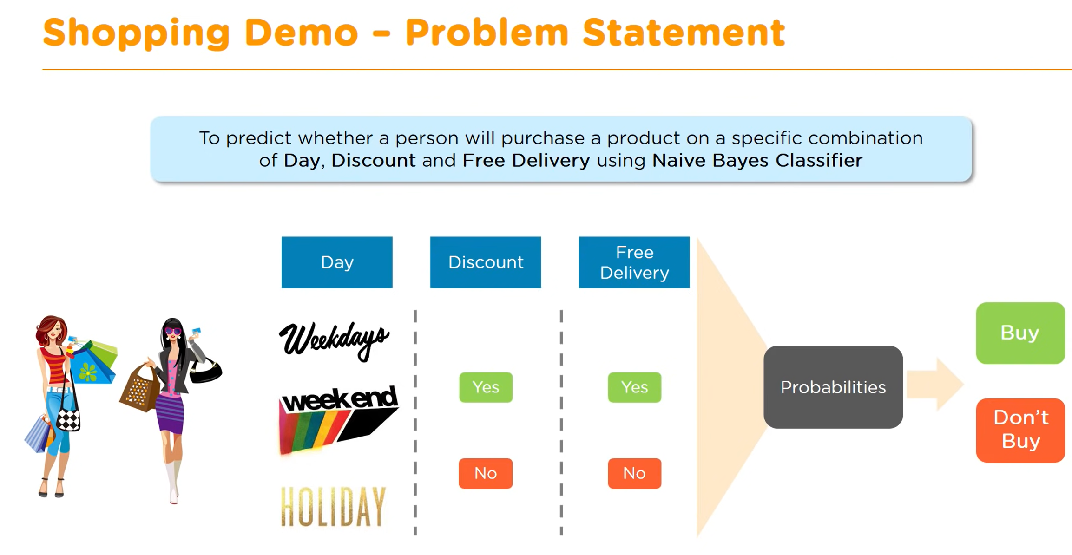
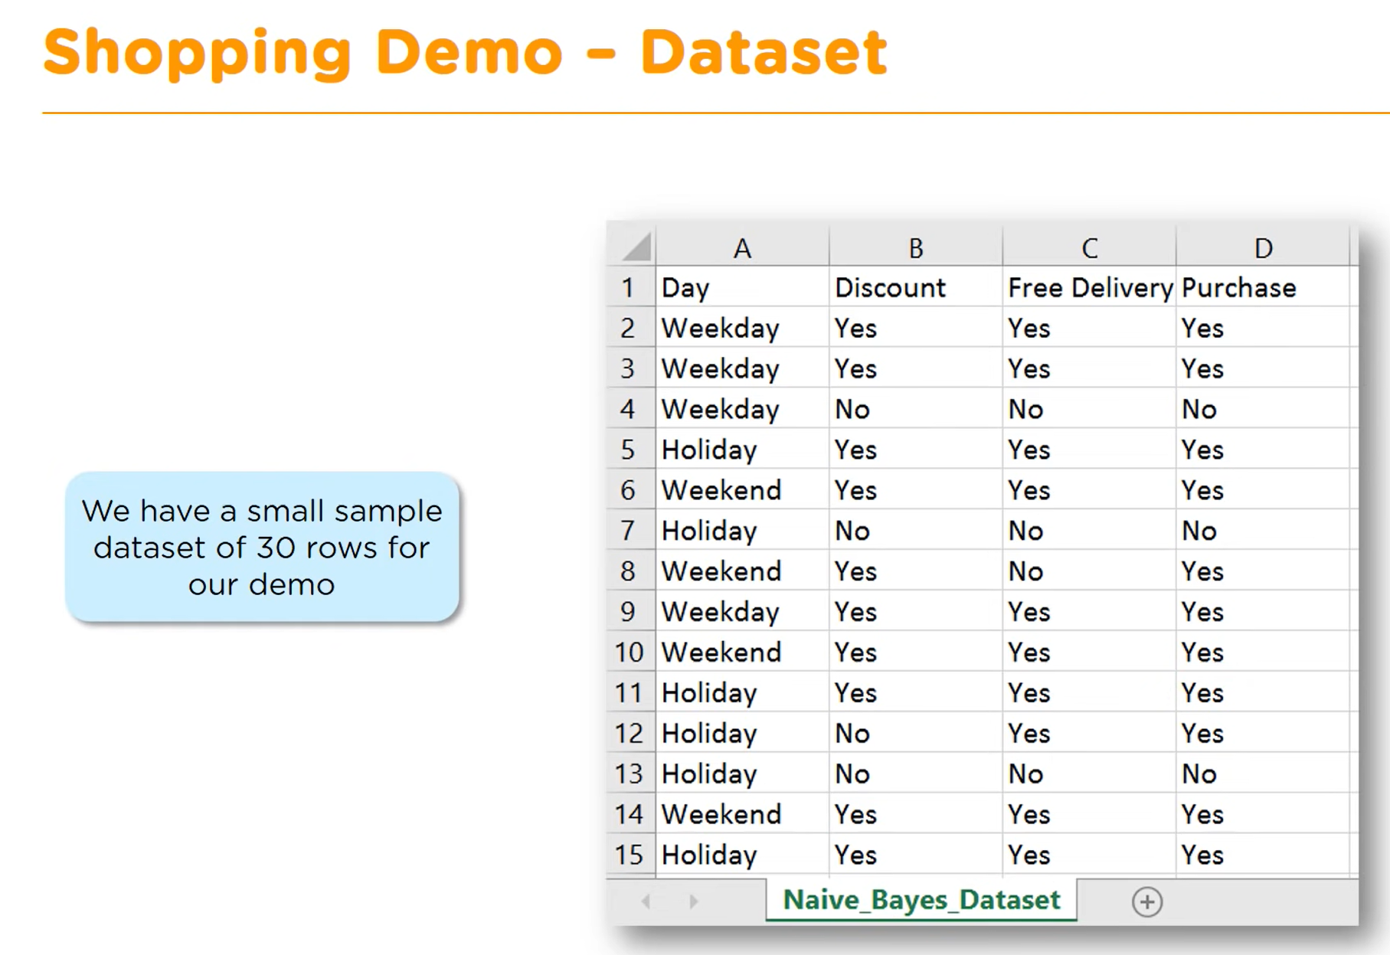

Slide 9
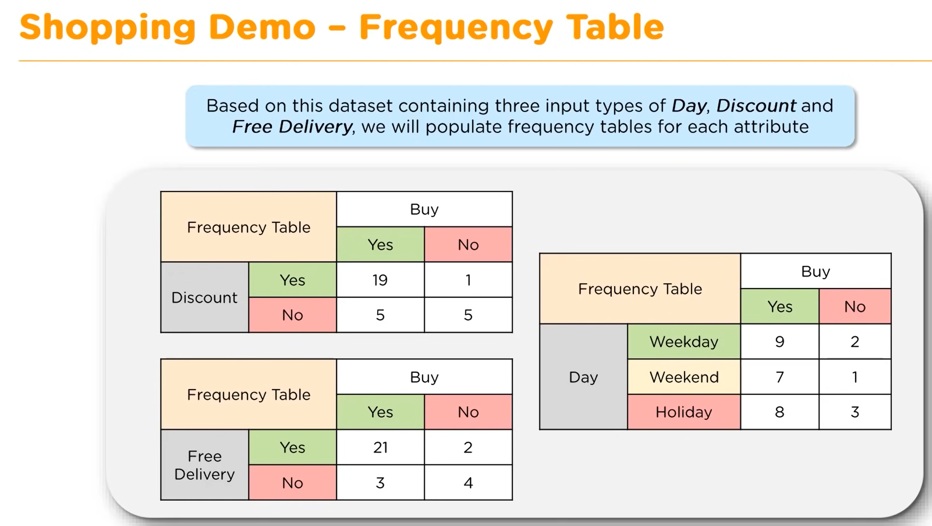

Slide 10
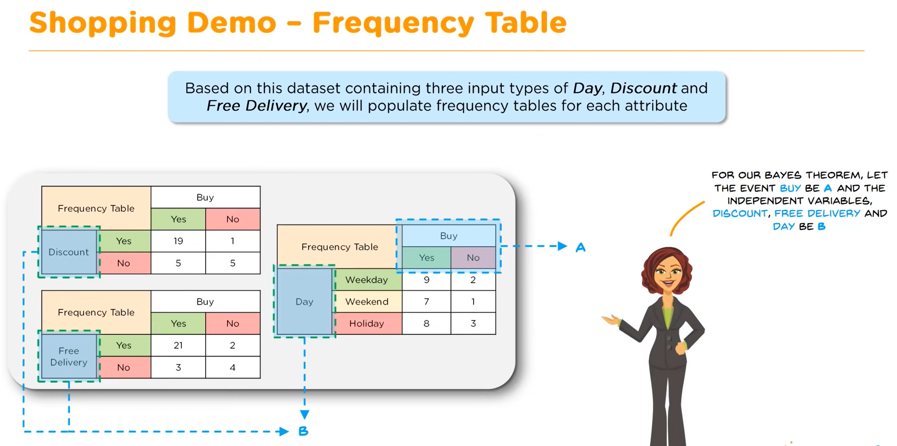

Slide 11
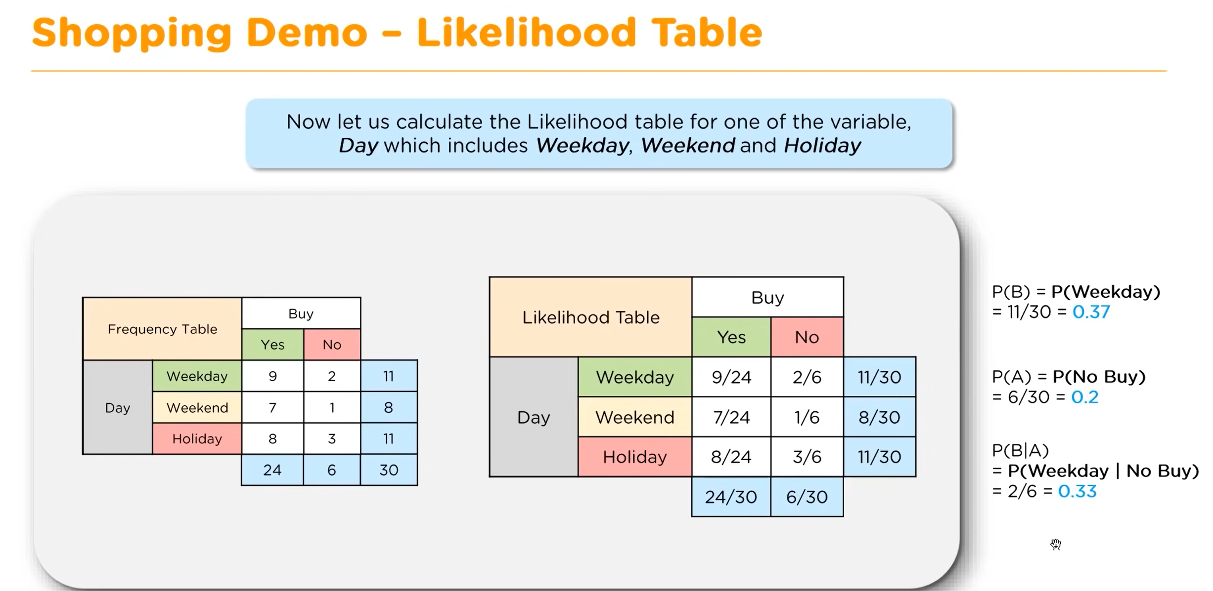

Slide 12
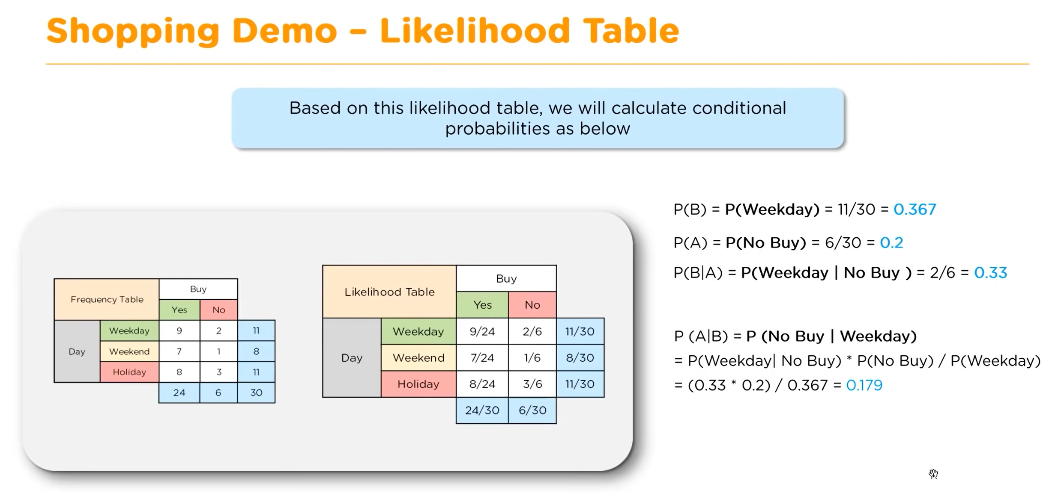

Slide 13
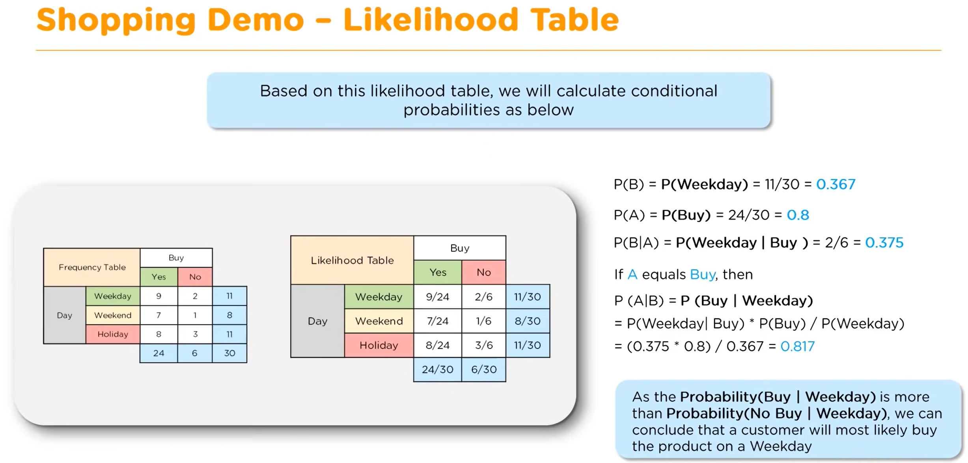

Slide 14
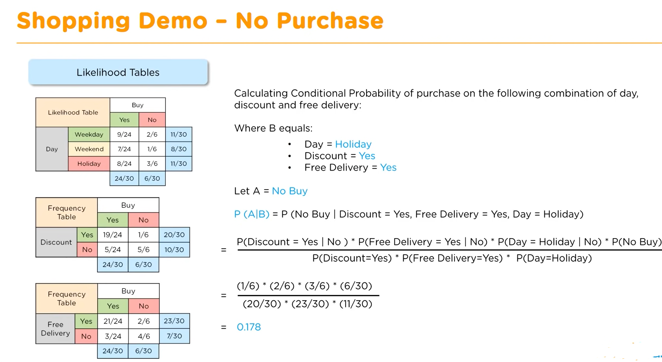

Slide 15
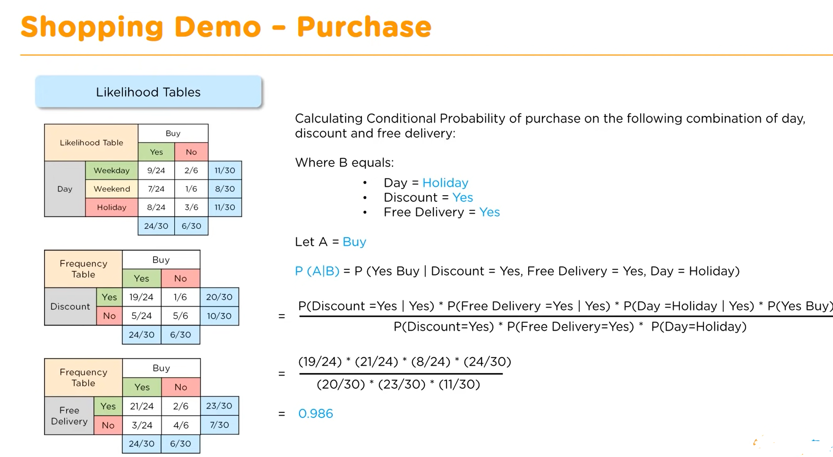

Slide 16
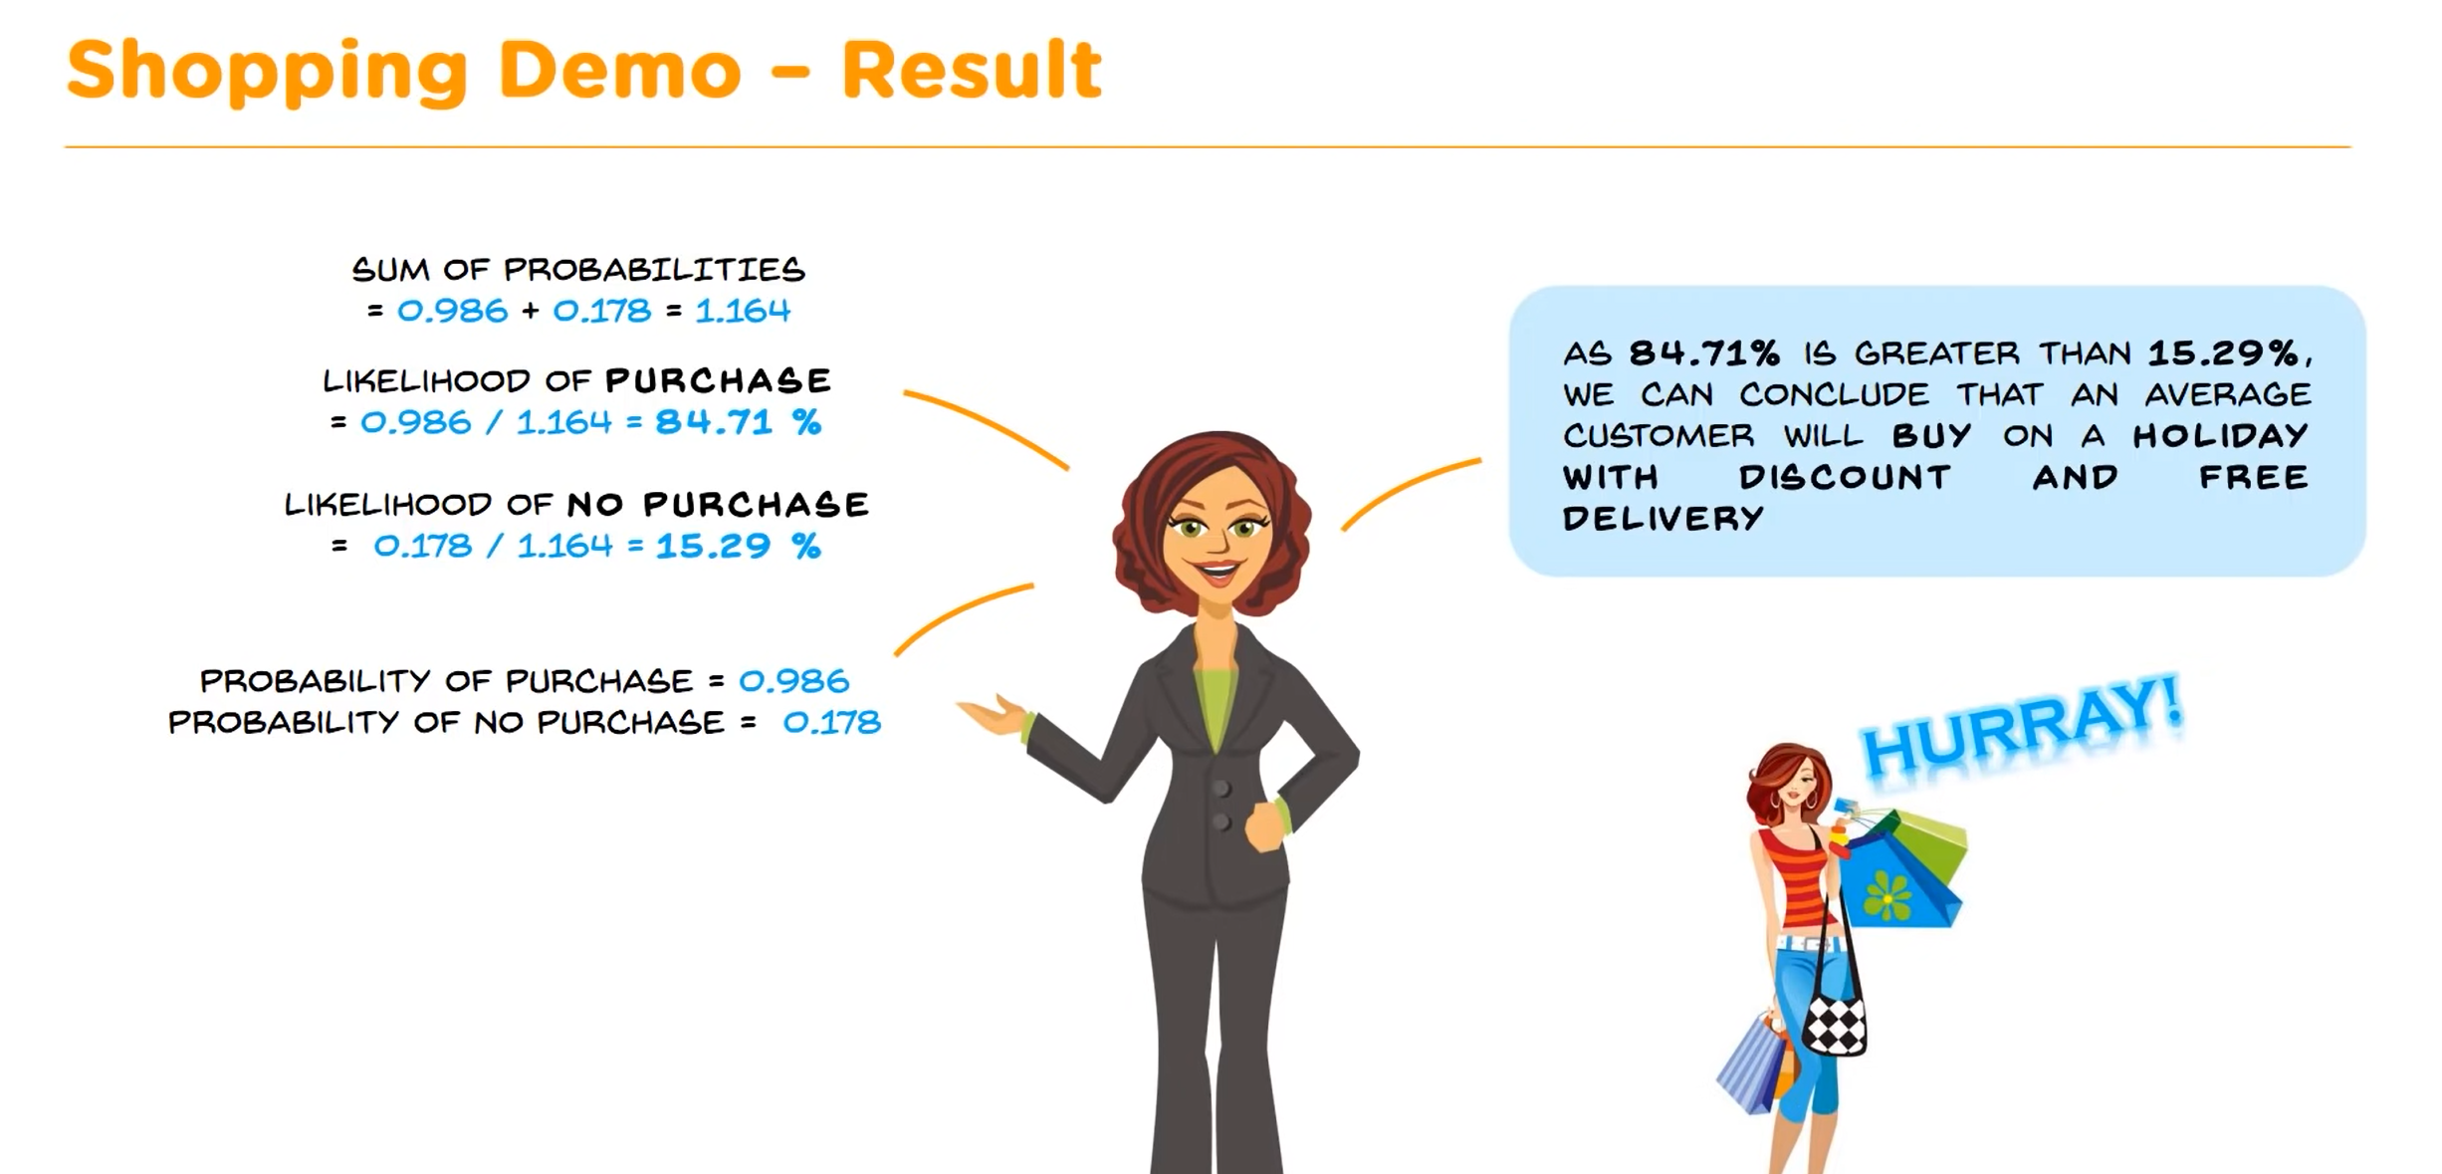

Slide 17
Maximum Entropy Algorithm ➔ Classifier ➔ Prediction ML Algorithm

Slide 18
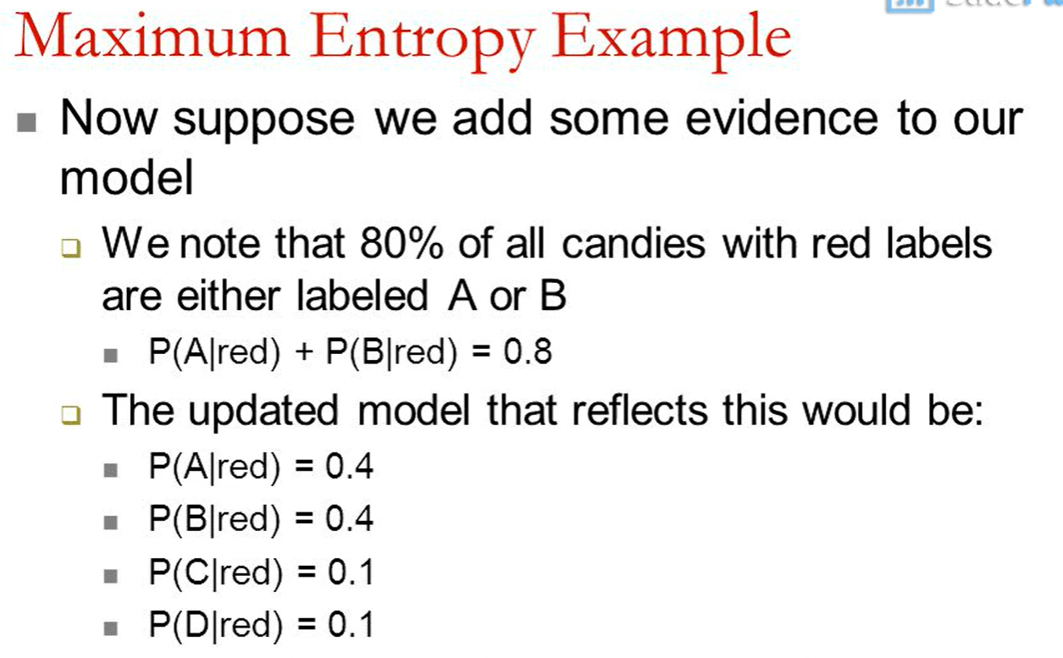
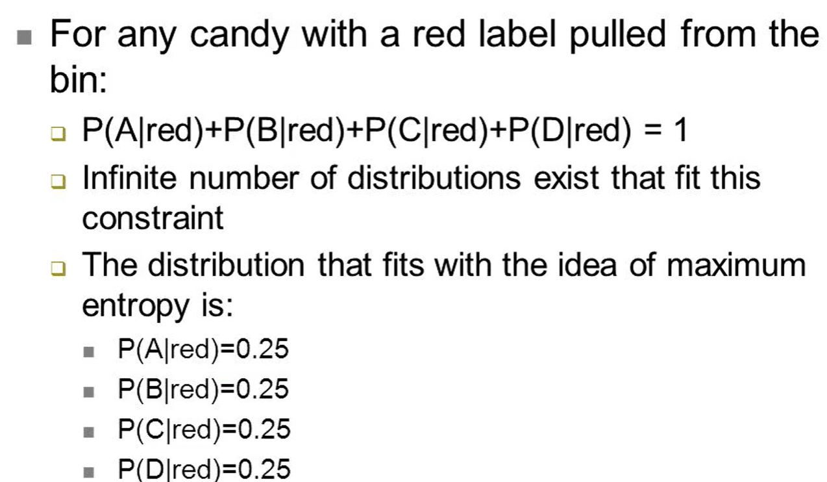

Slide 19
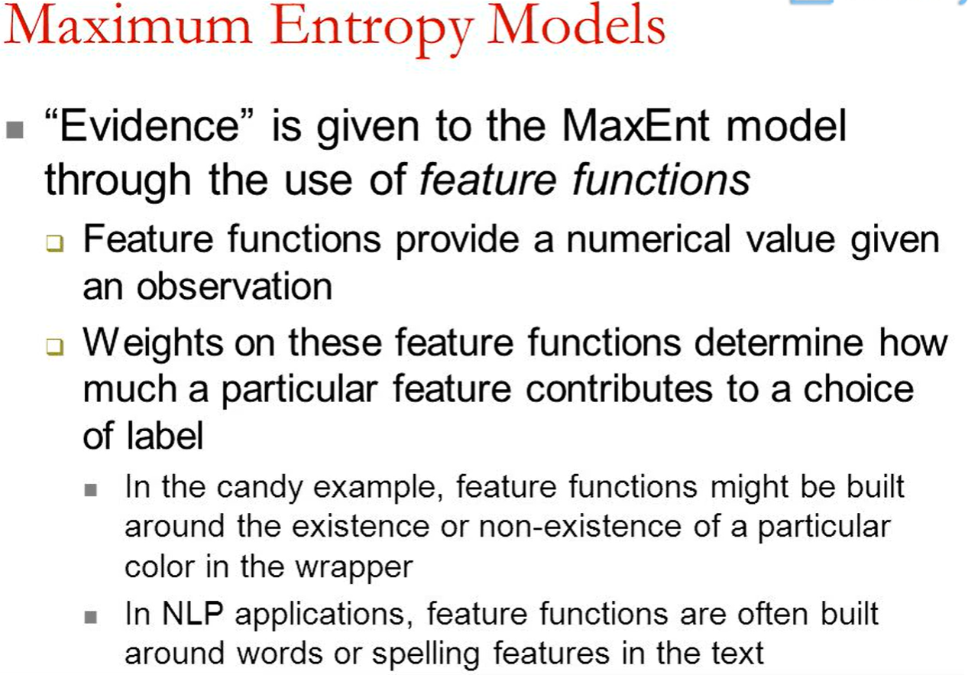

Slide 20
Informatica Classifier Transformation

Slide 22
Task 1 : Create new Physical Object ➔ Twitter

Slide 23
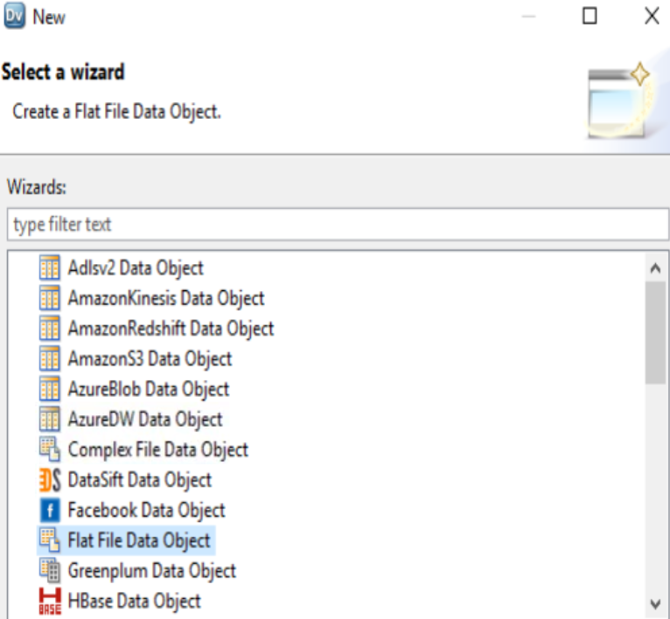
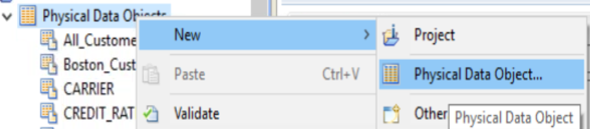
Step 1 : Create New Physical Data Objects

Slide 24
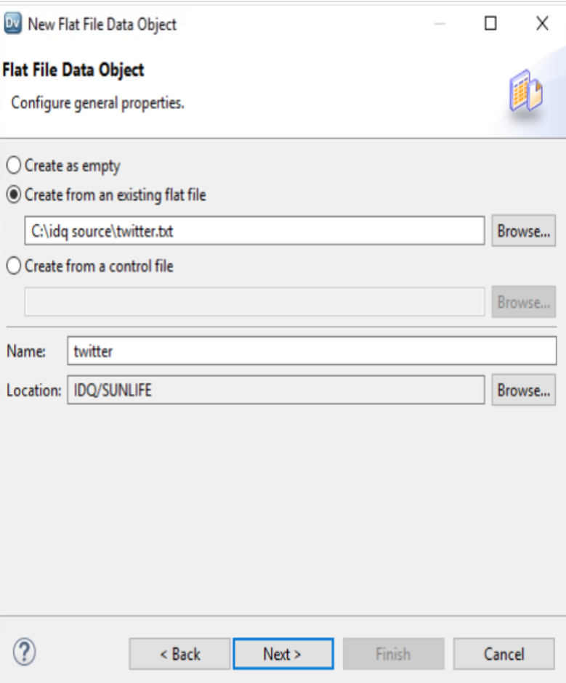
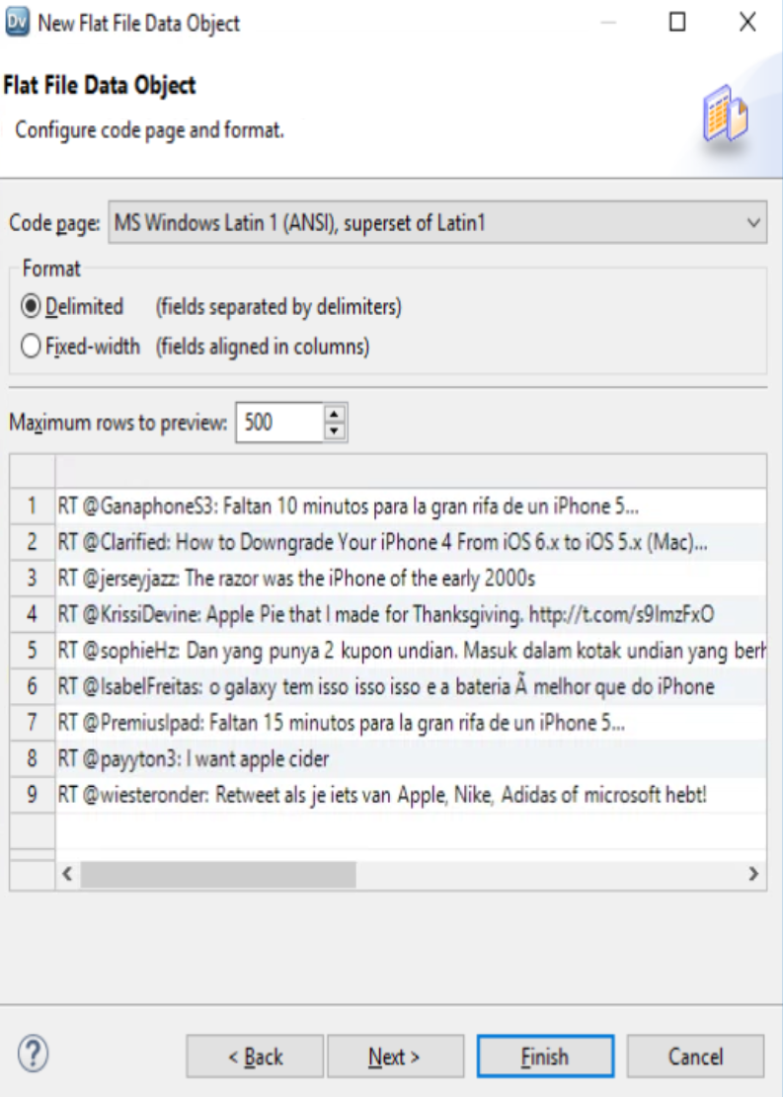
Step 2 : Create New Physical Data Objects , Name : Twitter.txt Delimited = Format

Slide 25
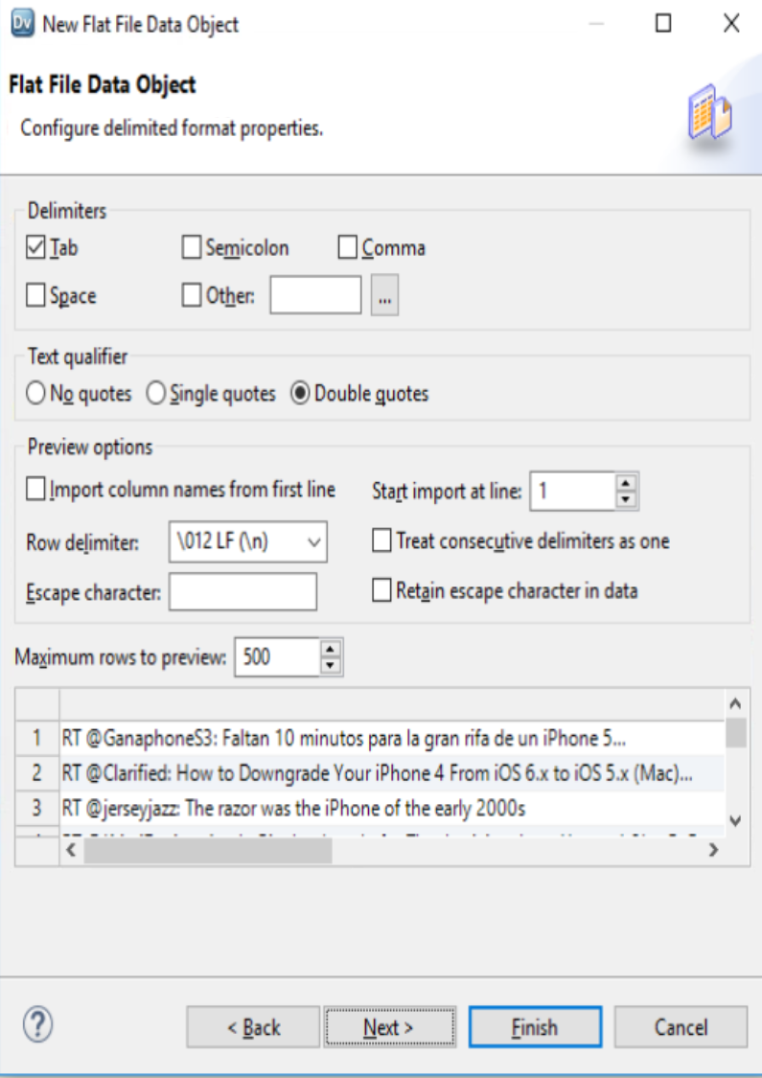
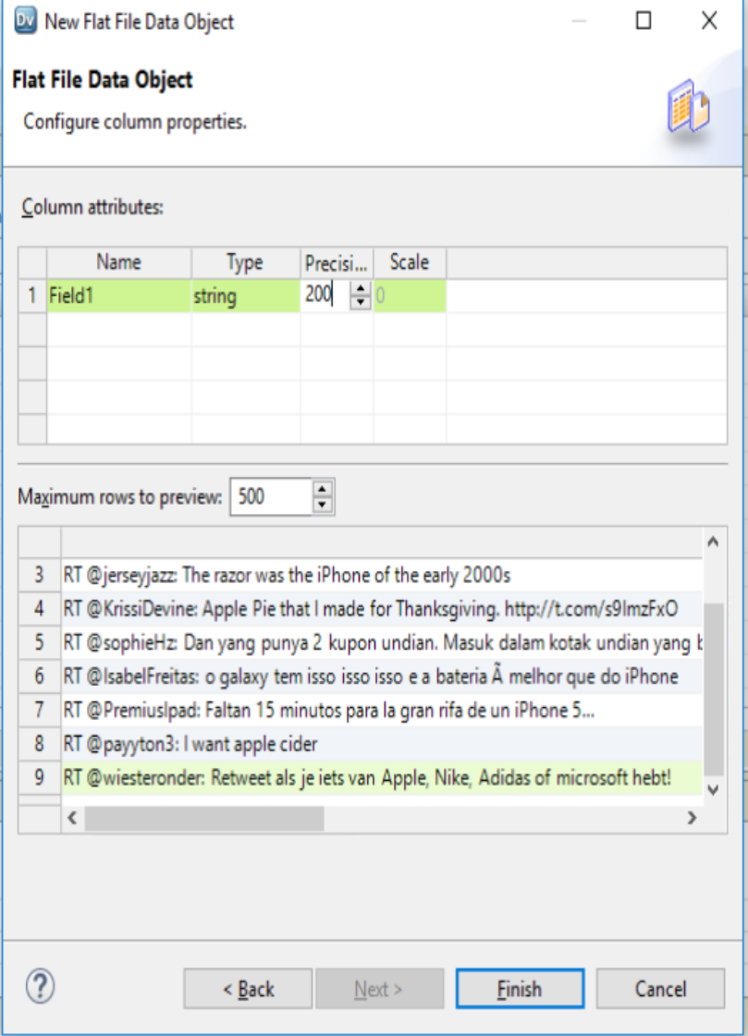
Step 3 : Create New Physical Data Objects
Delimiter = Tab Text Qualifier ➔ Double Quotes , Column Name ➔ Field1 ,string 200 ➔ Click Finish

Slide 26
Task 2 : Create new Content Set and Configure Classifier Model in Content Set

Slide 27
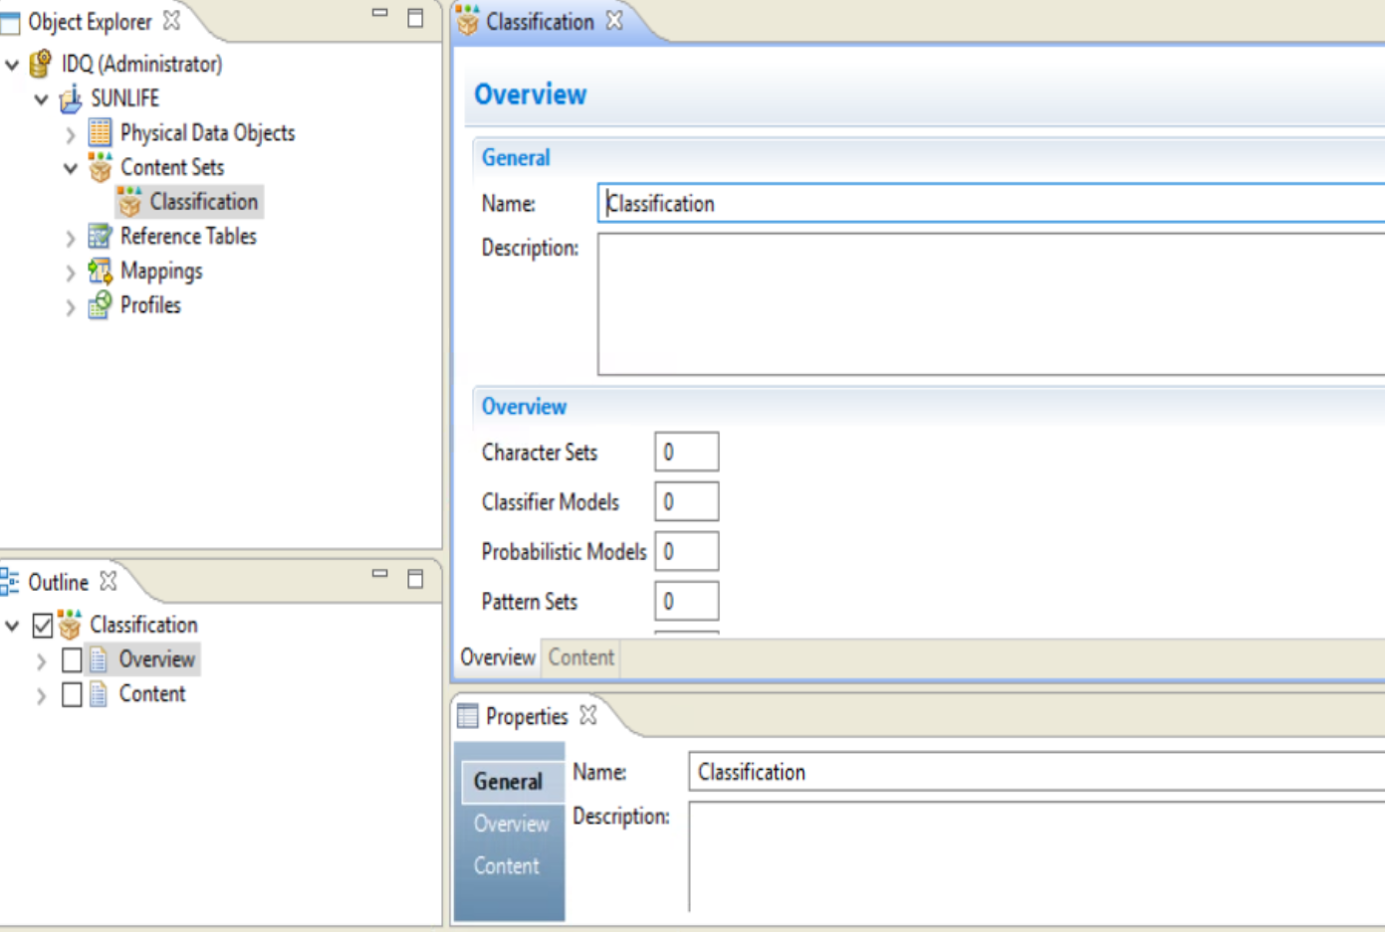
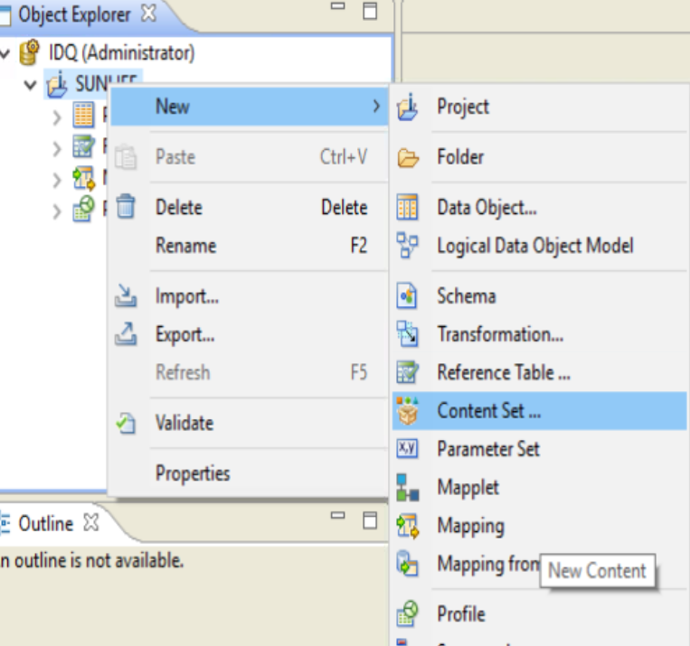
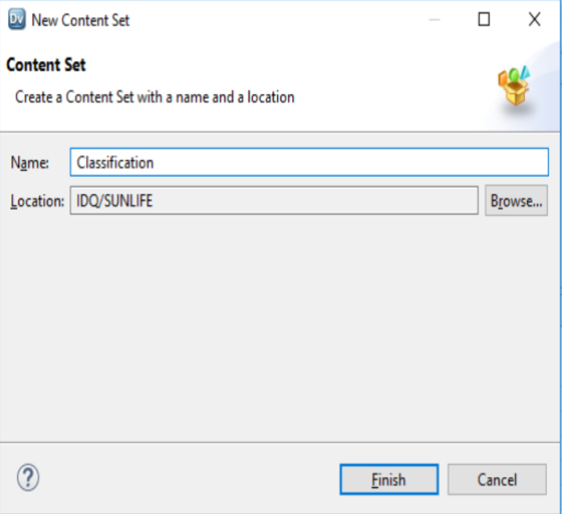
Step 4 : Create Content Set or Open Existing Content Set
1. Create New Content Set
2. Name Content ➔ Classification
3. Open Content Set

Slide 28
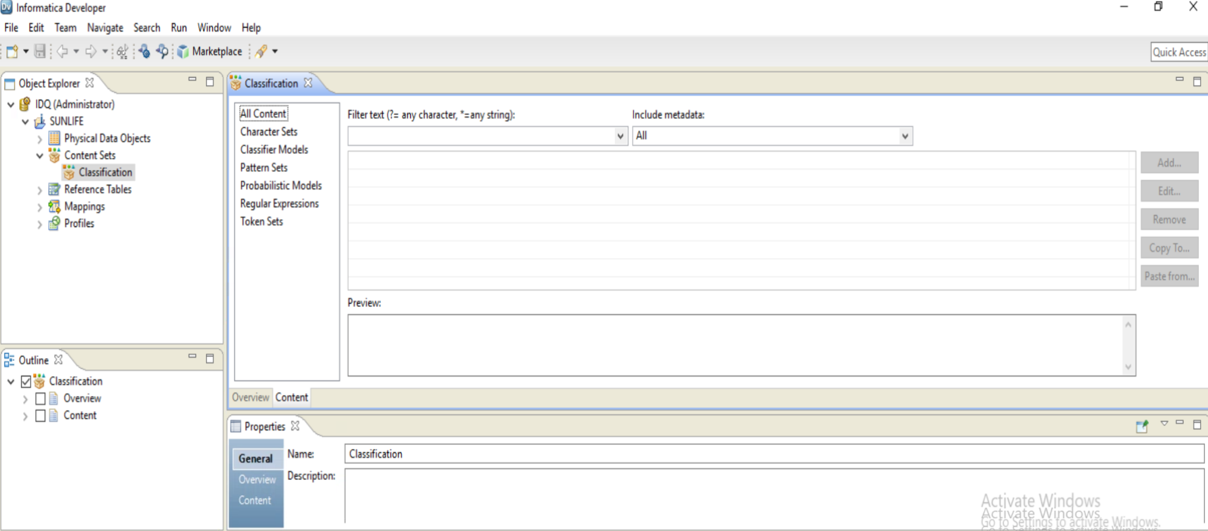
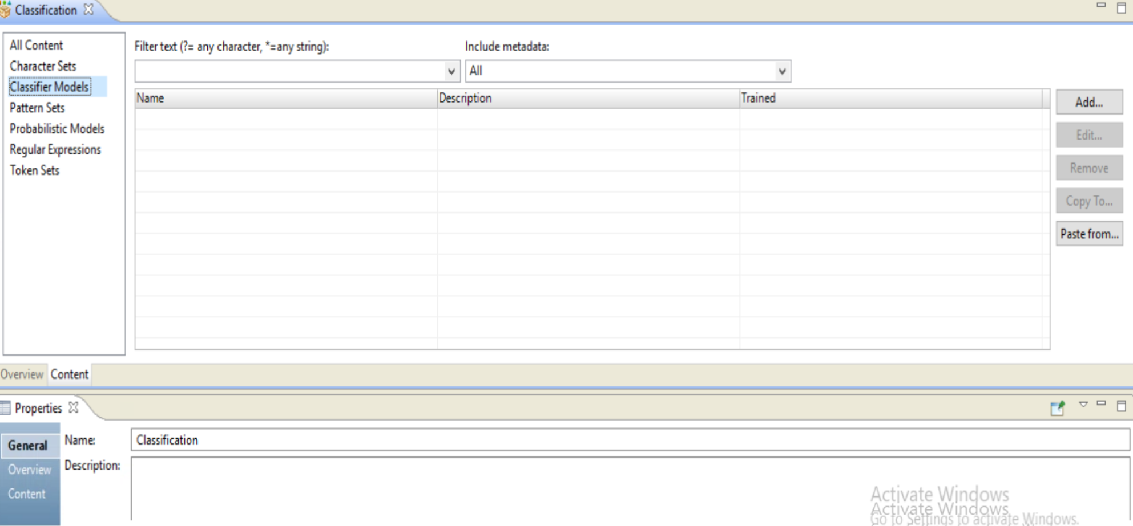
Step 5 : Configure content set
Open Content Set Model
Add Content Set Modeler

Slide 29
Classifier Model Building Process

Slide 33
Task 3 : Create new Classifier Model in Content Set

Slide 34
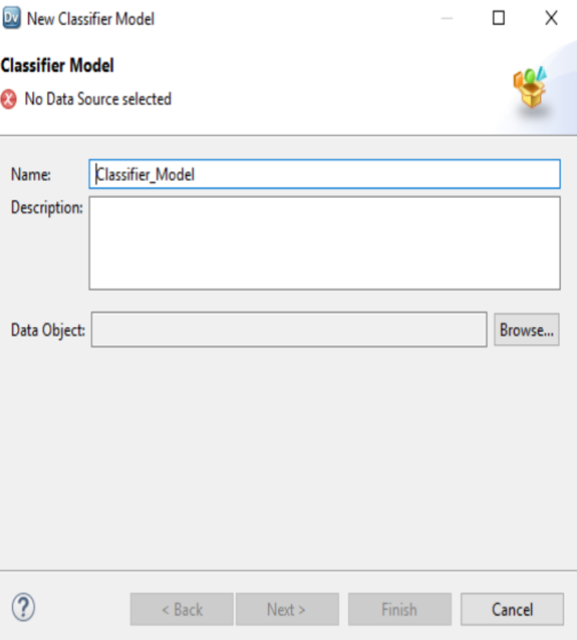
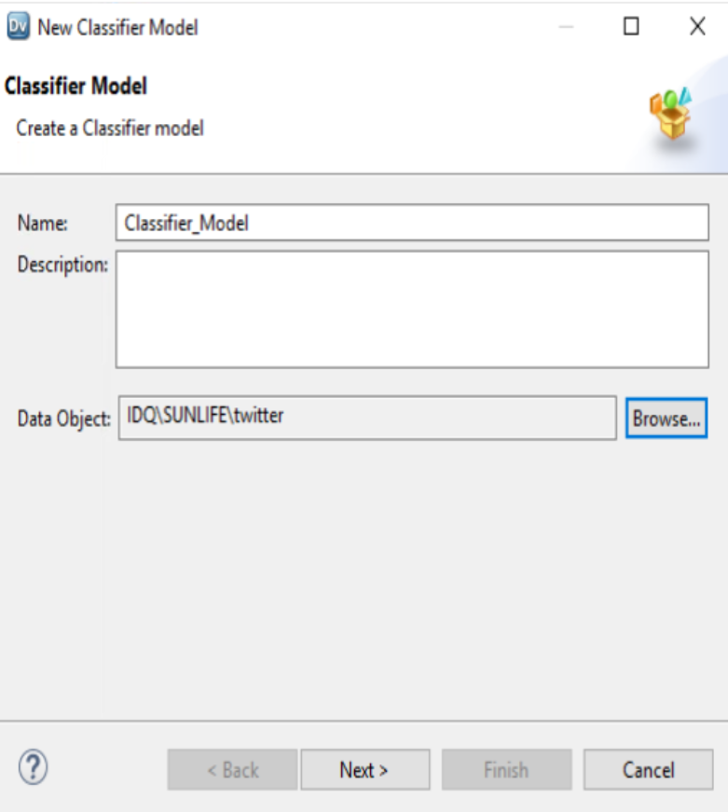
Step 6 : Configure Content Set for Classifier
A Add Classifier Model Content Set
Browse Input Dataset ➔ Choose Twitter for Trained Model ➔ click next

Slide 35
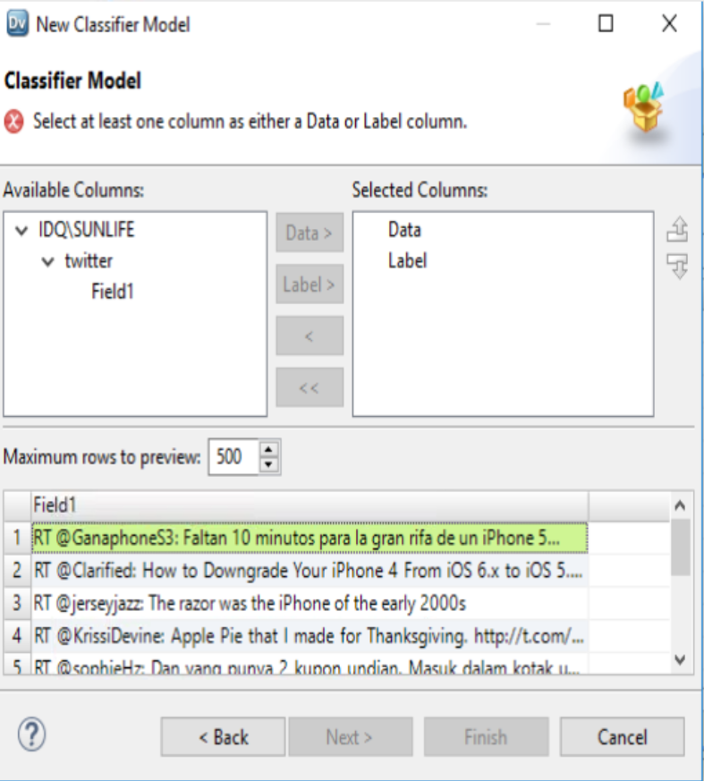
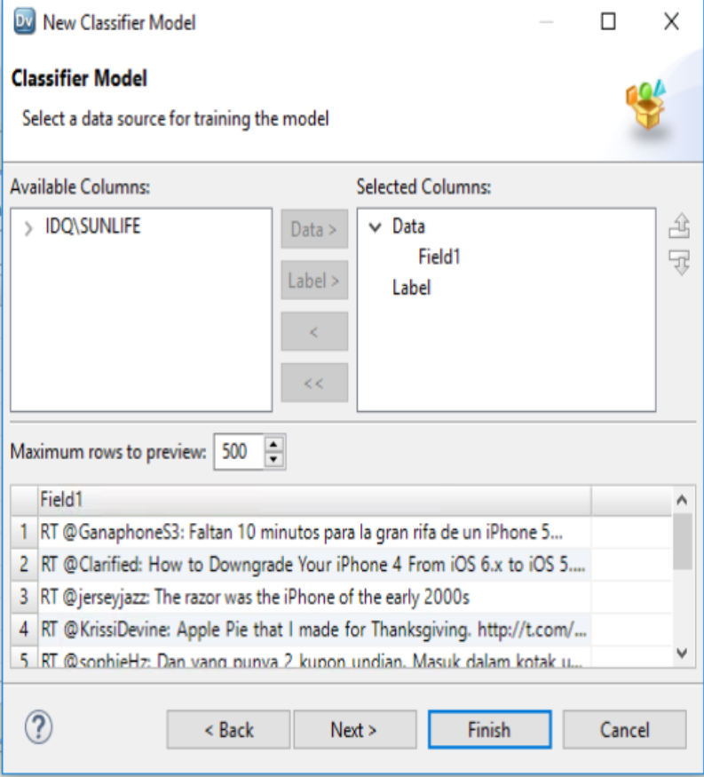
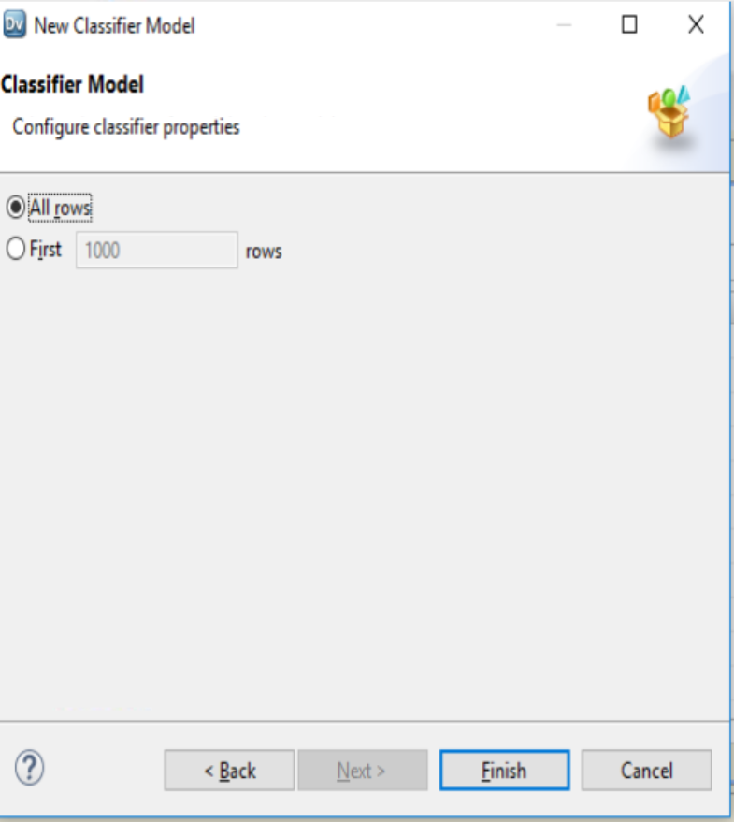
Step 7 : Create Content Set or Open Existing Content Set
Since it is A Base Model we don’t have LABEL , We only have data
Add field1 to DATA Column
Click on Finish

Slide 36
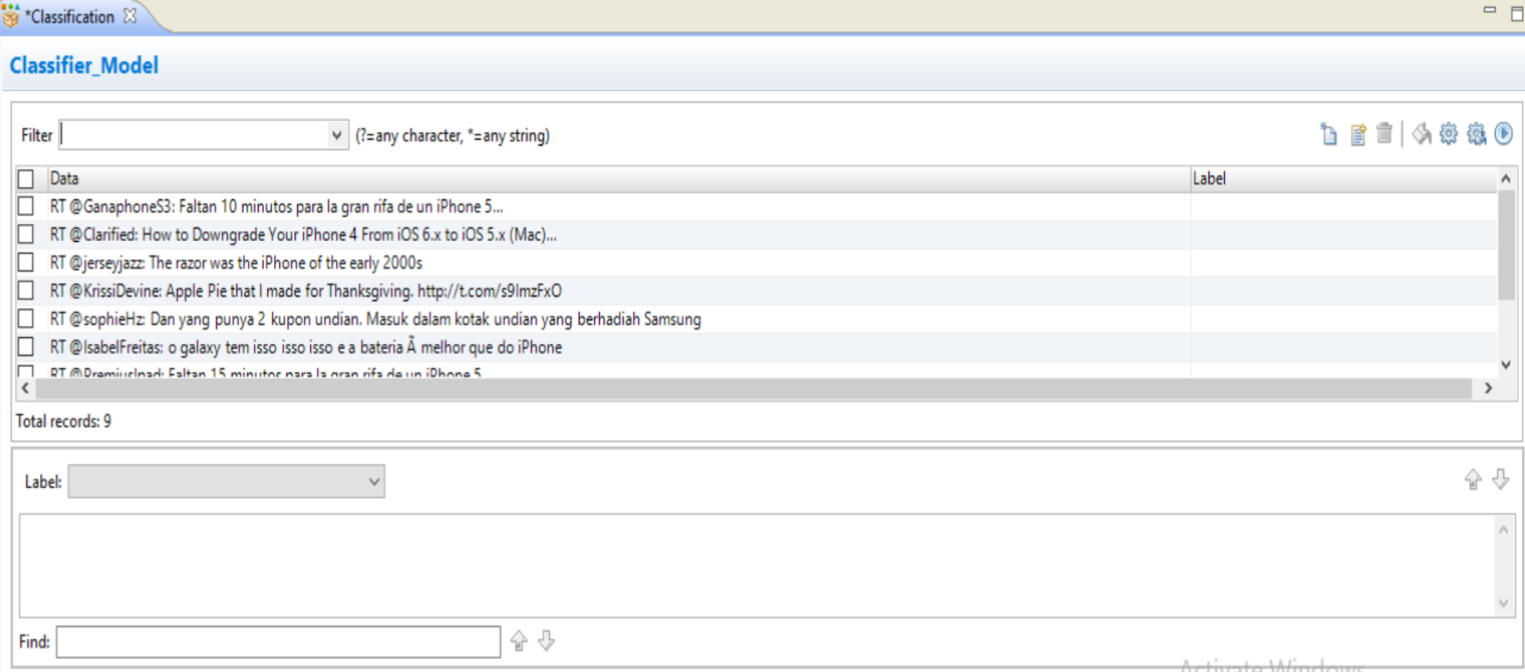
Step 8 : Create Content Set or Open Existing Content Set

Slide 37
Task 3 : Content Set ➔ Classifier Model ➔ Manage and Assign Label

Slide 38
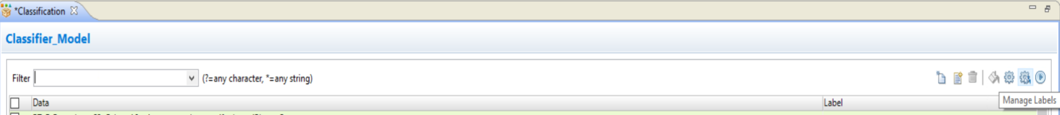
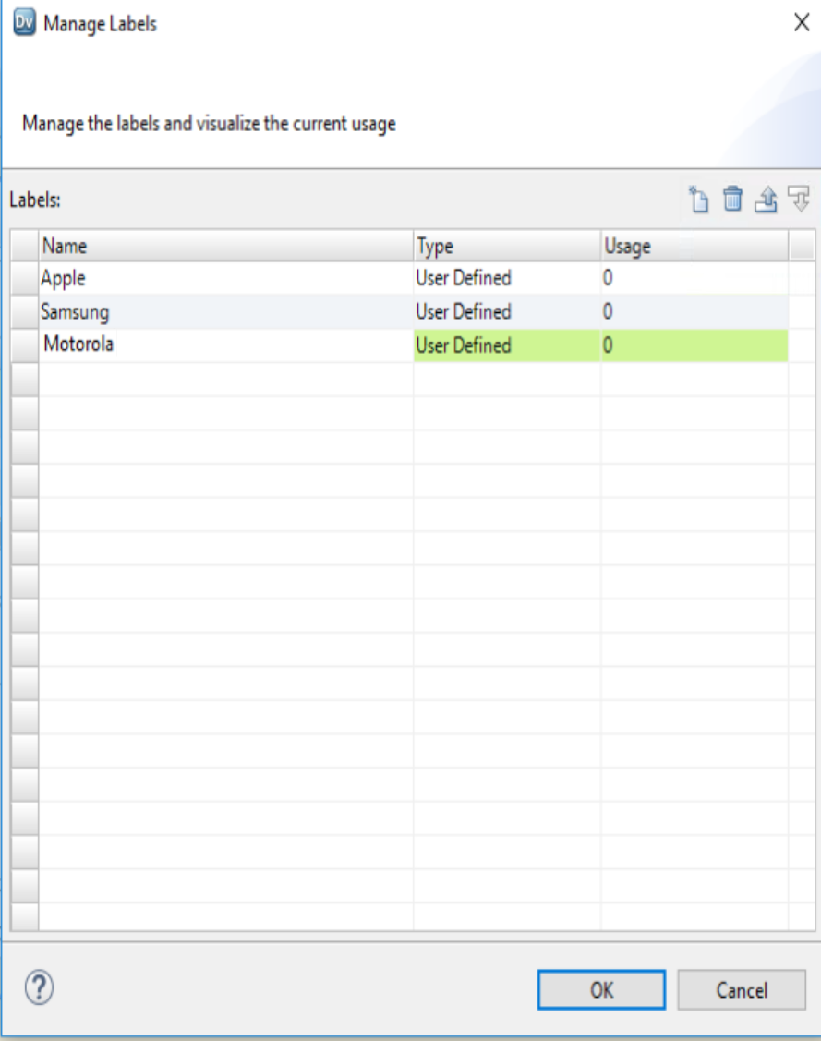
Step 9 : Manage Labels and Add Three Labels
Add label Apple , Samsung and Motorola

Slide 39
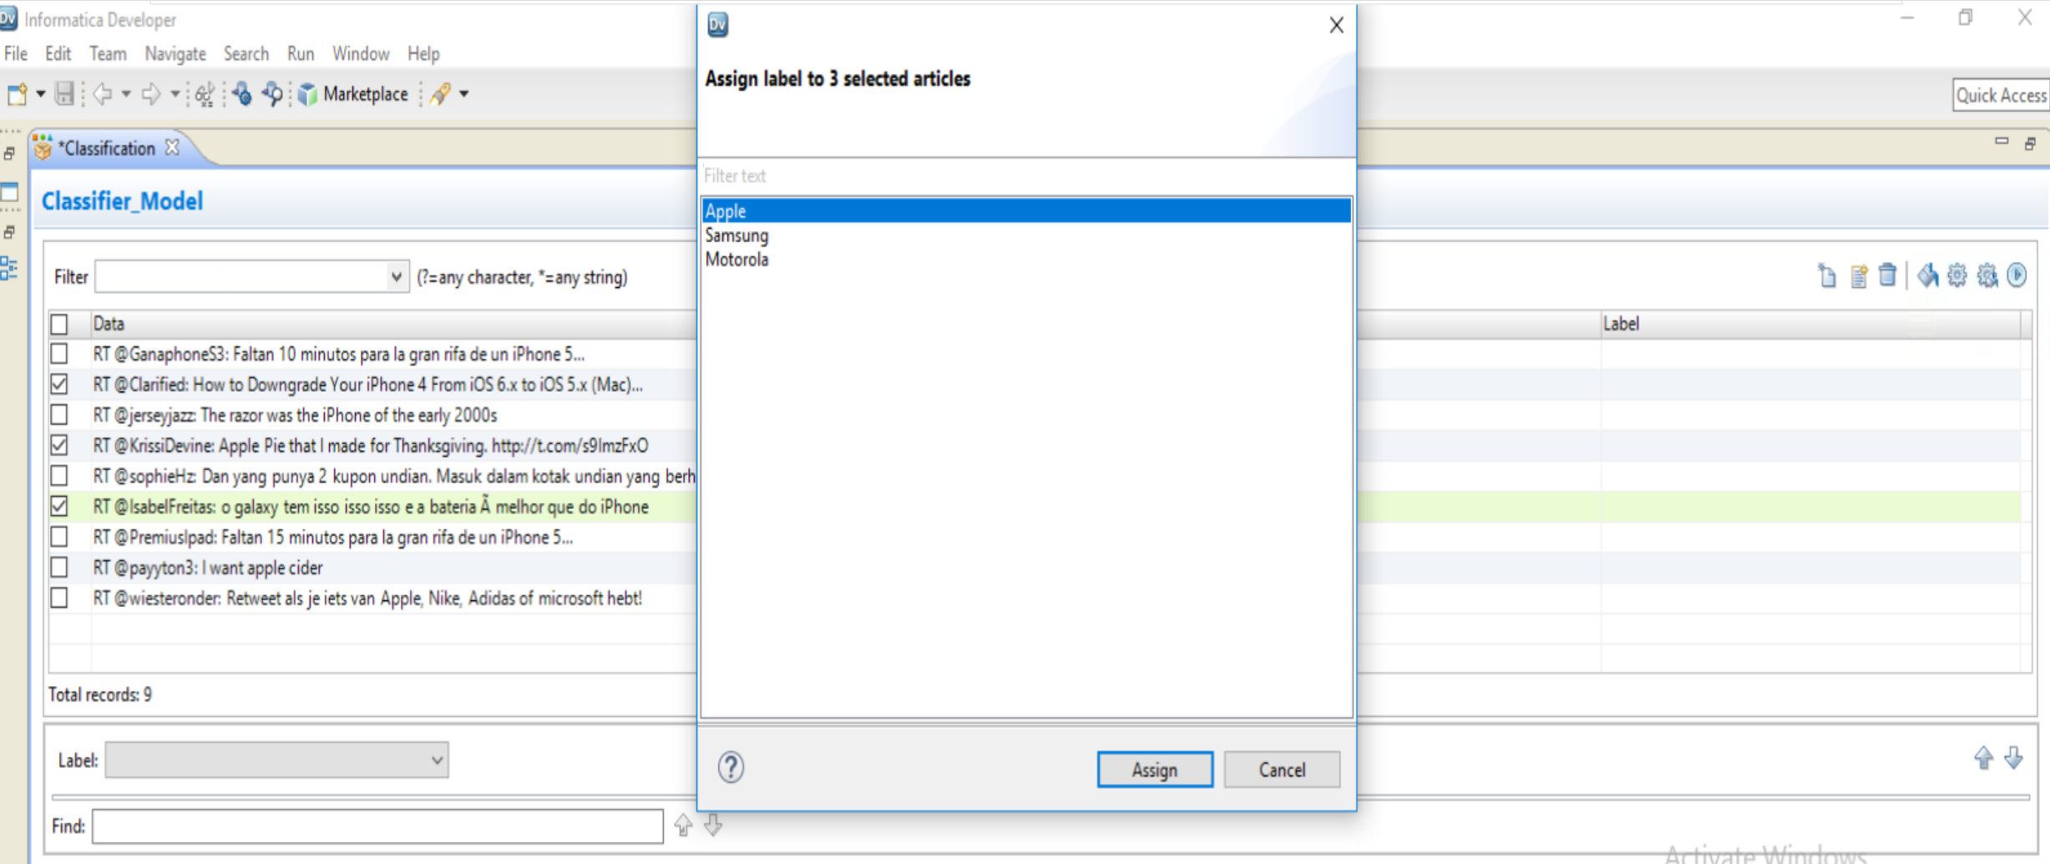
Step 10 : Assign label Apple to Data , Choose 2, 4, 7 Record
Choose Label and Assign data to it

Slide 40
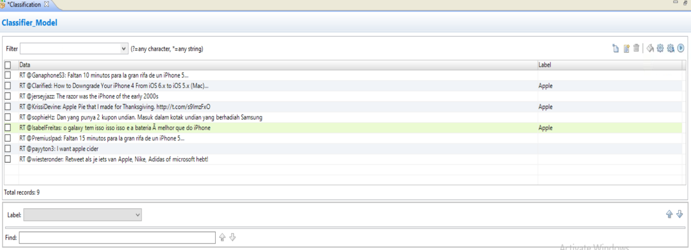
Step 1 : Assign Apple Label to 2,4,7 Record

Slide 41
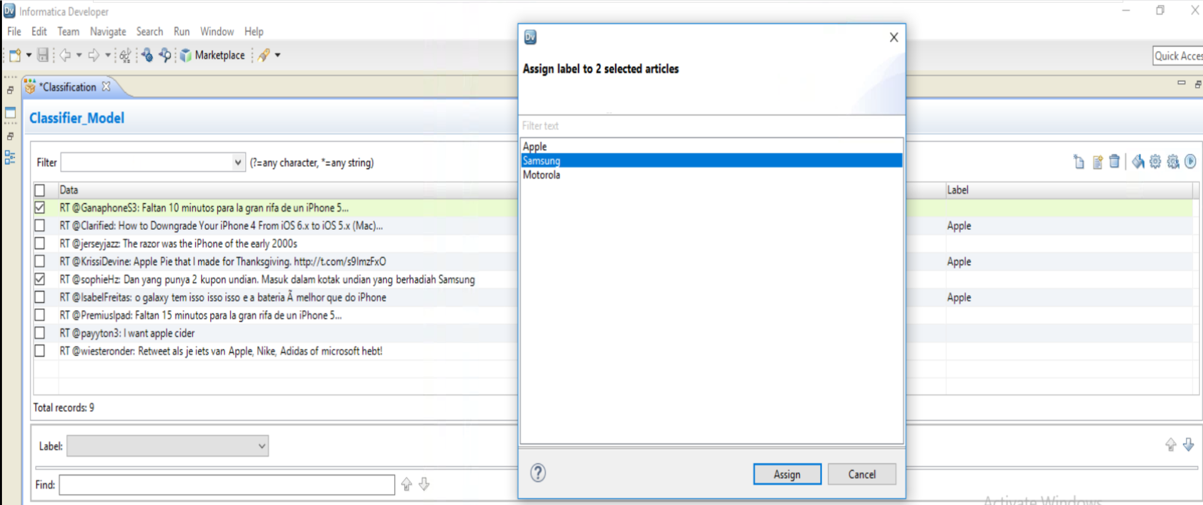
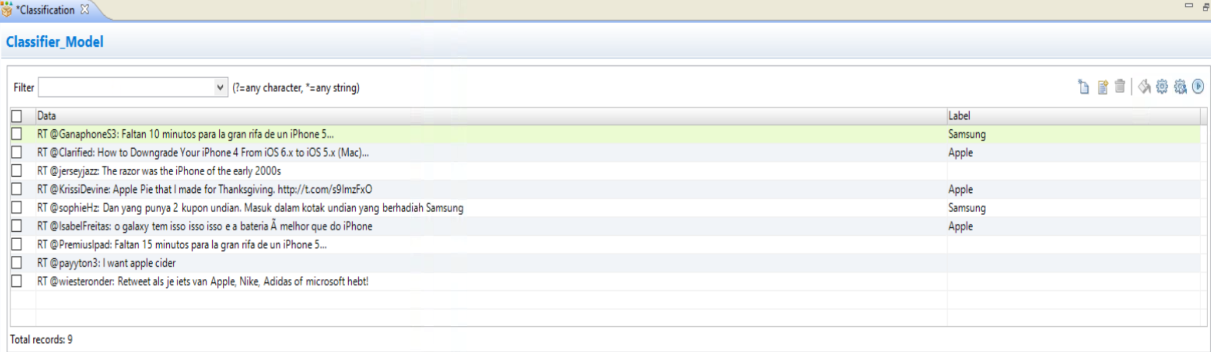
Step 1 : Assign Samsung Label to 1 ,6 Record

Slide 42
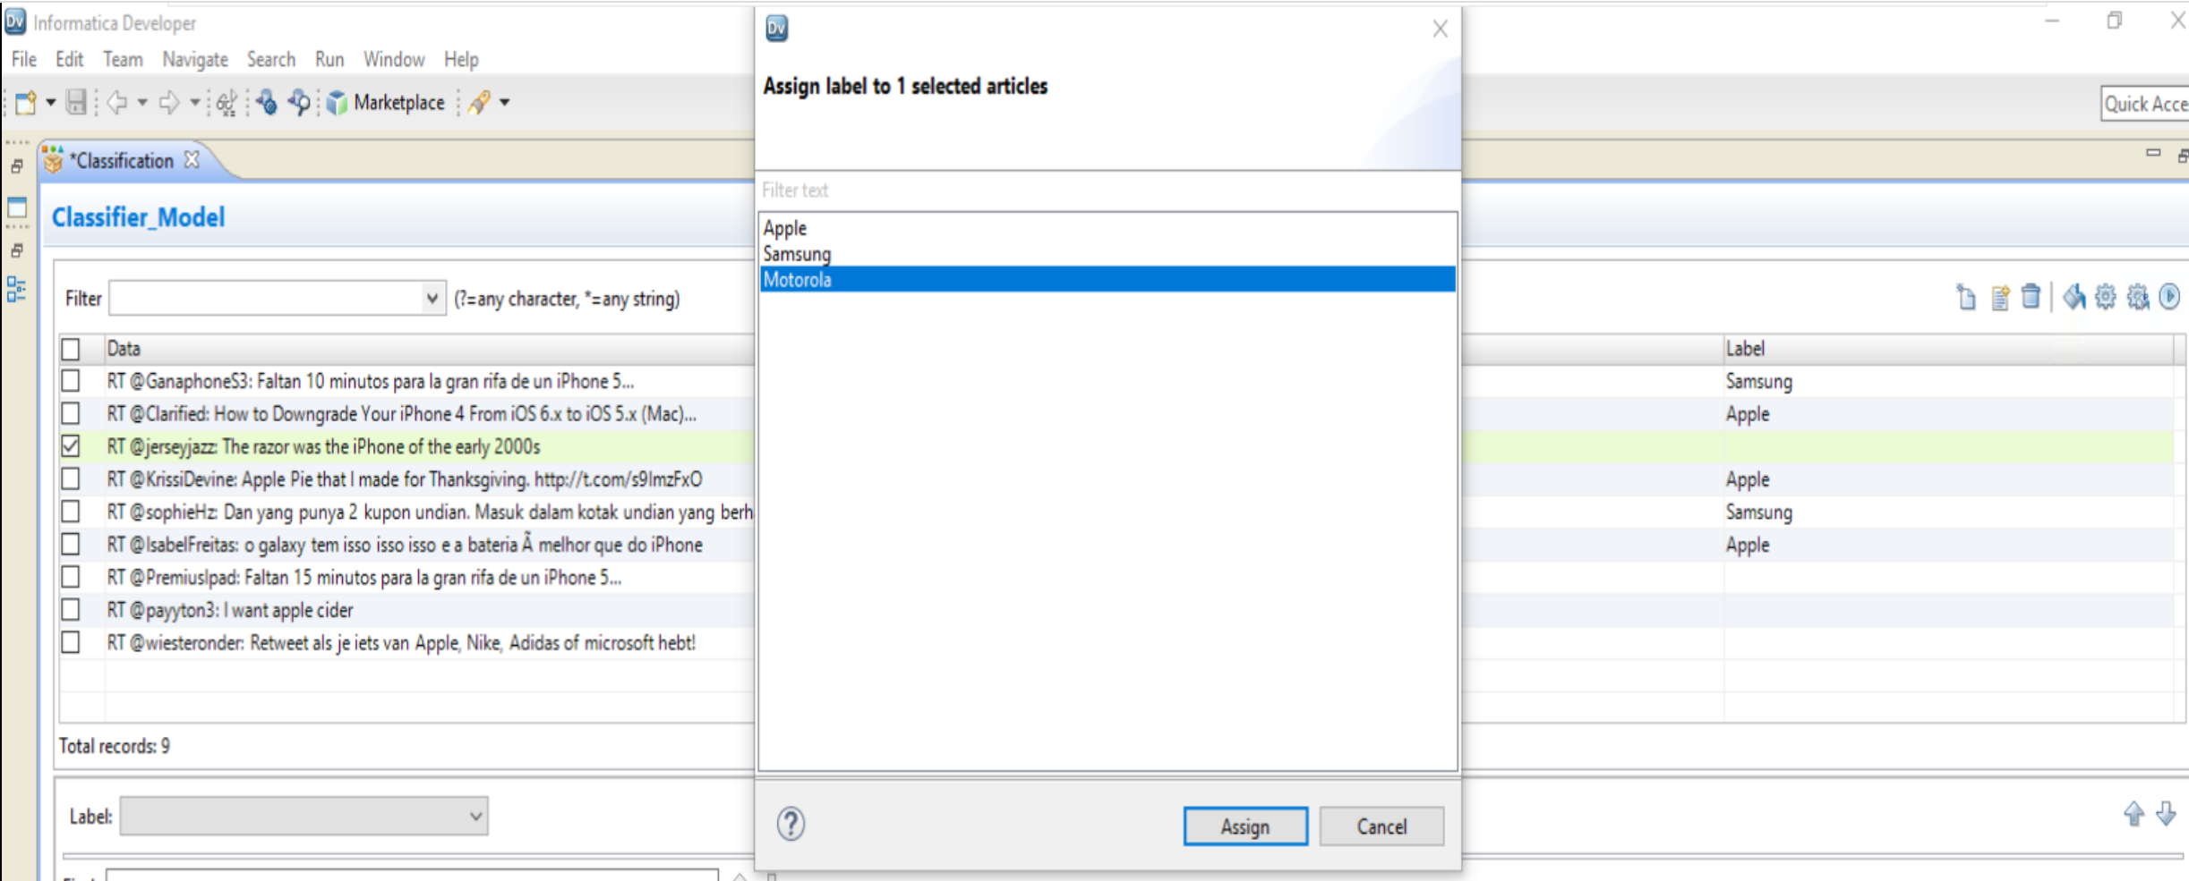
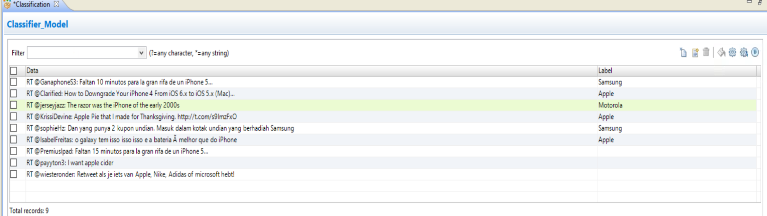
Step 1 : Assign Motorola Label to 3 Record

Slide 43
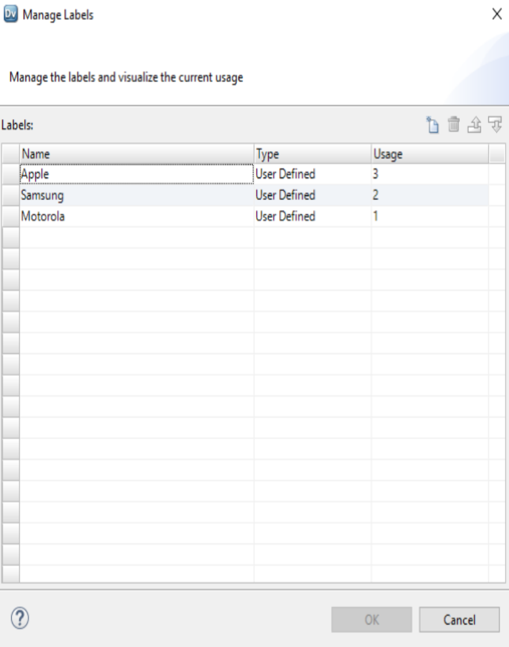
Click on Manage label to CHECK uSAGE

Slide 44
Task 4 : Content Set ➔ Classifier Model ➔ Save and Compile Trained Model

Slide 45
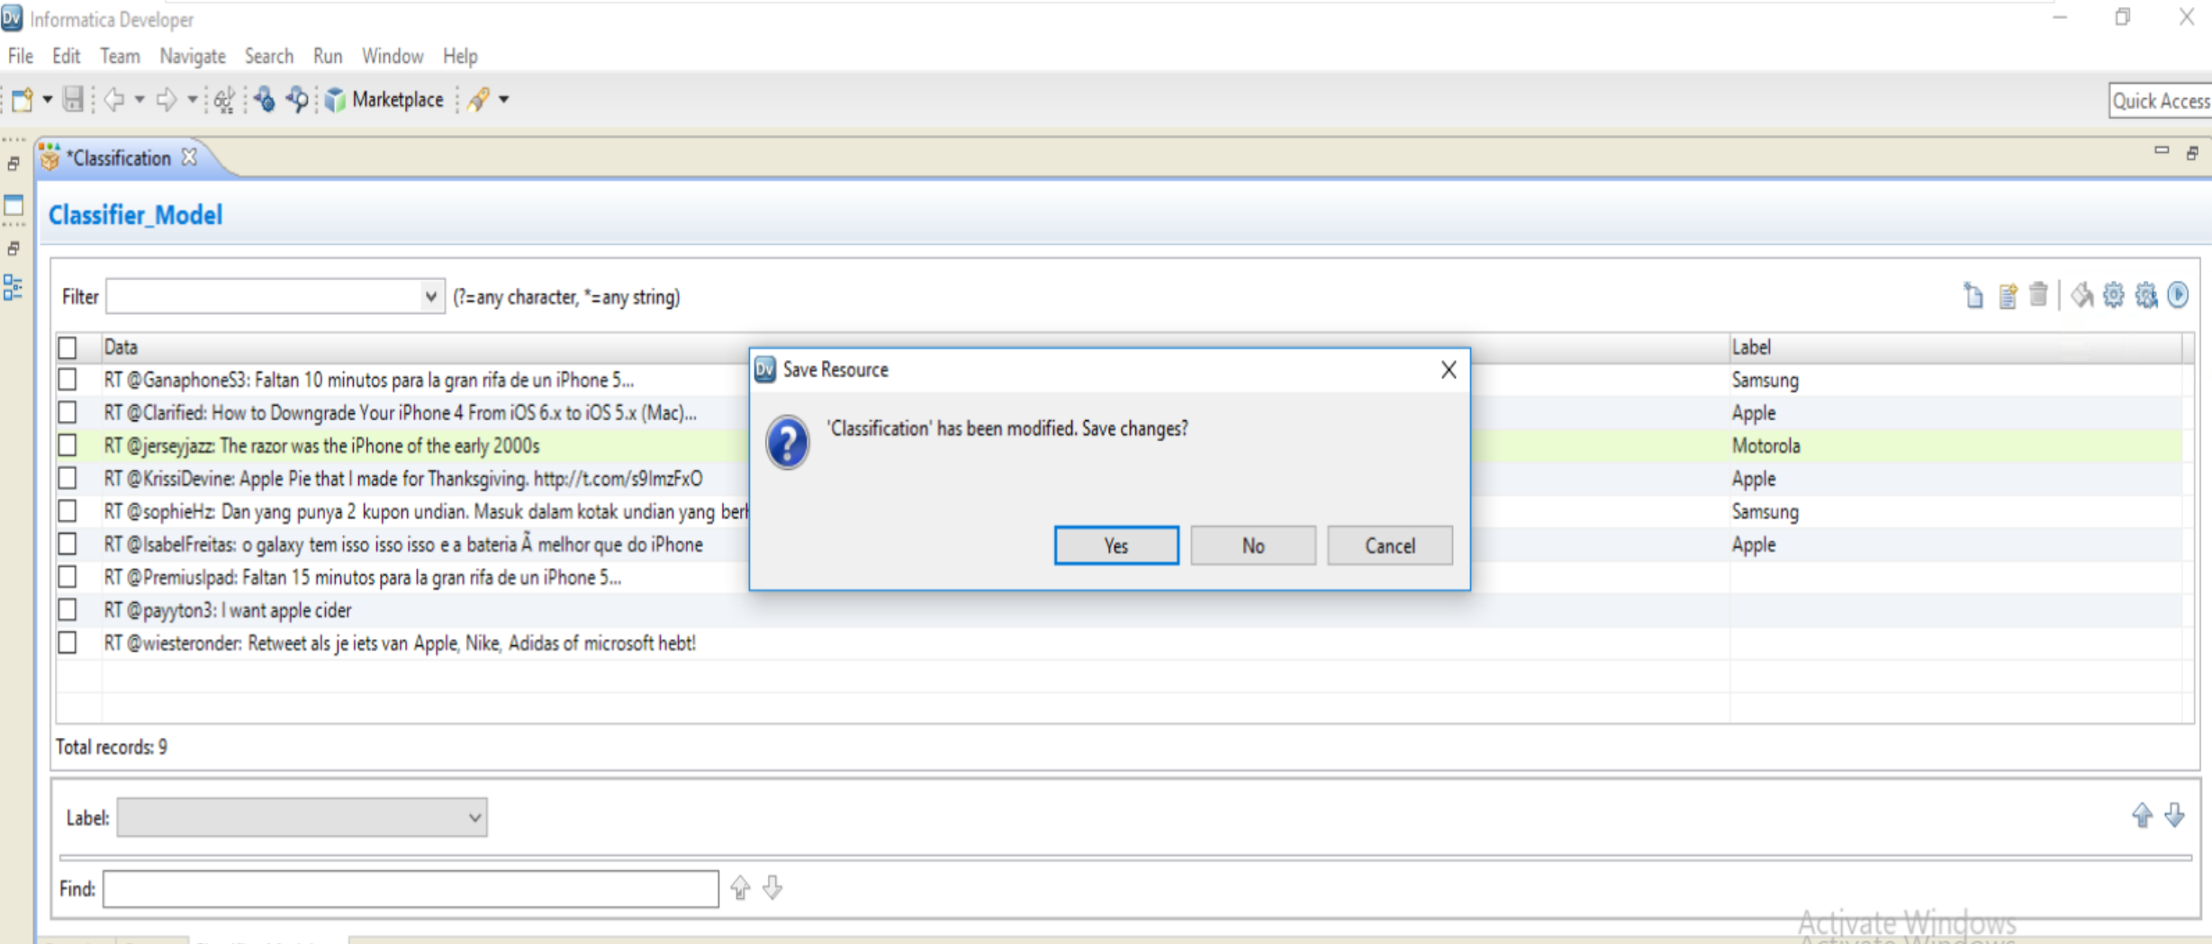
Save Classification Model

Slide 46
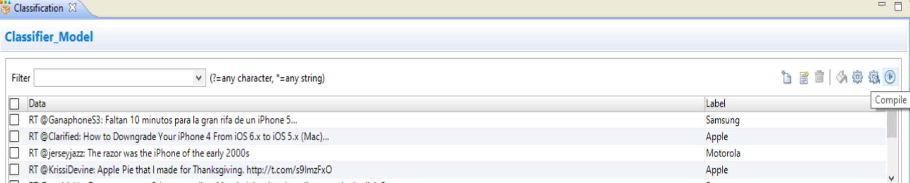
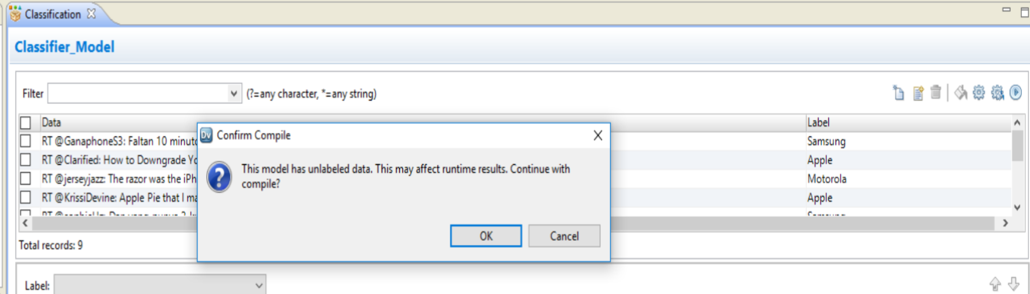
Compile and the Model

Slide 47


Slide 48
Task 5 : Create New Mapping to Check Classifier Model

Slide 49

Step 1 : Create New Mapping to Check Classifier Model

Slide 50


Step 2 : Develop Mapping to Check Classifier
Choose Twitter Physical Data object as Read
Add Transformation ➔ Classifier

Slide 51

Step 3 : Drag Twitter Field1 Input Column to Classifier Input

Slide 52
Task 6 : Configure Classifier Model

Slide 53


Step 4 : Configure Classifier ➔ Right Click on Classifier Properties
Add New Strategy == Input as Field1 ➔ click next

Slide 54


Step 5 : Configure Classifier ➔ Right Click on Classifier Properties
Choose Algorithm ➔ Choose Classifier Model Available ➔ Click Finish
Choose Classify Operation ➔ Click Next

Slide 55


Step 6 : Run Data Viewer
Run Data Viewer

